Slide 1


Outer Dowsing Offshore Wind
Community Liaison Group
February 2023

Slide 2
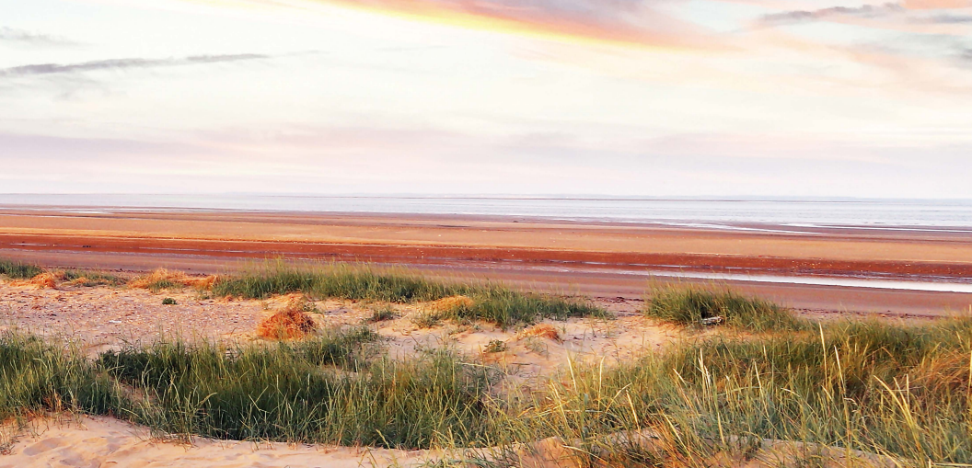

Agenda
Outer Dowsing Offshore Wind - CLG
Item: |  | Timing (approx.)
1 | Coffee and tea | 10 mins​
2 | Chair’s welcome and introductions | 10 mins​
3 | Feedback from Consultation Events | 10 mins​
4 | Project Update - Alternative cable route option and further consultation | 10 mins​
5 | Key Feedback and Our Response | 20 mins​
4 | Question and answer session / discussion on future topics | 20 mins​
5 | AOB | 5 mins​
6 | Chair’s closing remarks and next steps / next meeting | 5 mins​

Slide 3
A quick reminder of what we hope to achieve with these Community Liaison Groups…
Our Aims …
To involve key local stakeholders in the design and development of the Outer Dowsing Offshore Wind project (landfall, onshore cable route and substation) through presentations, discussions and planned workshop activities.
To act as a two-way communication channel between local communities and the project team.
To help foster local involvement and ownership of the project.
To facilitate focused discussions and ensure attendees can make the most out of the CLG’s – it is intended for these groups to be focused on concerns/ issues / thoughts relative to their specific local area.

Slide 4
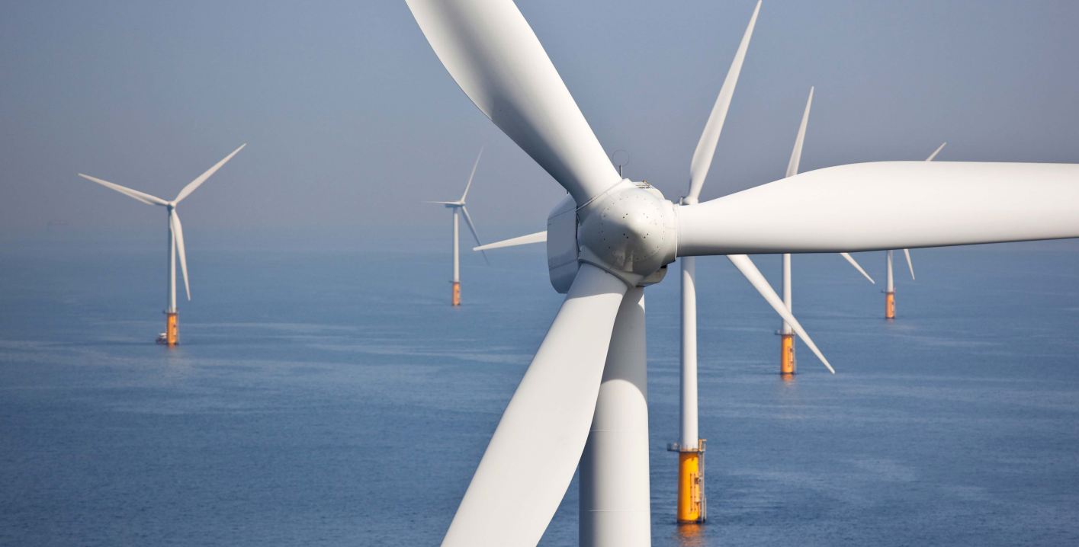


Welcome
Outer Dowsing Offshore Wind
Welcome to our second phase of Community Liaison Groups. Thank you very much for joining us this evening.
A little reminder of who we are…
The Project is a proposed offshore windfarm located approximately 54 kilometres off the coast of Lincolnshire, England.
The project comprises of a 1.5 GW offshore generating station, and offshore and onshore transmission infrastructure. Outer Dowsing Offshore Wind is being developed by Corio Generation (a wholly-owned Green Investment Group portfolio company) and TotalEnergies.

Slide 5
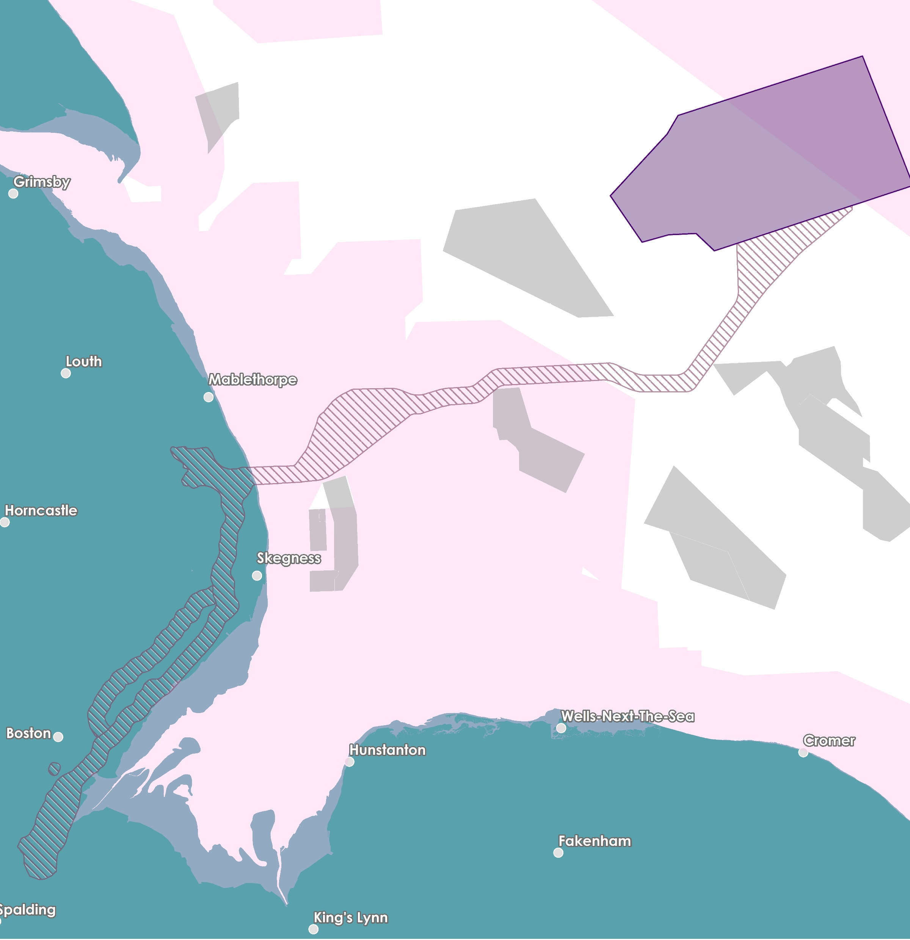

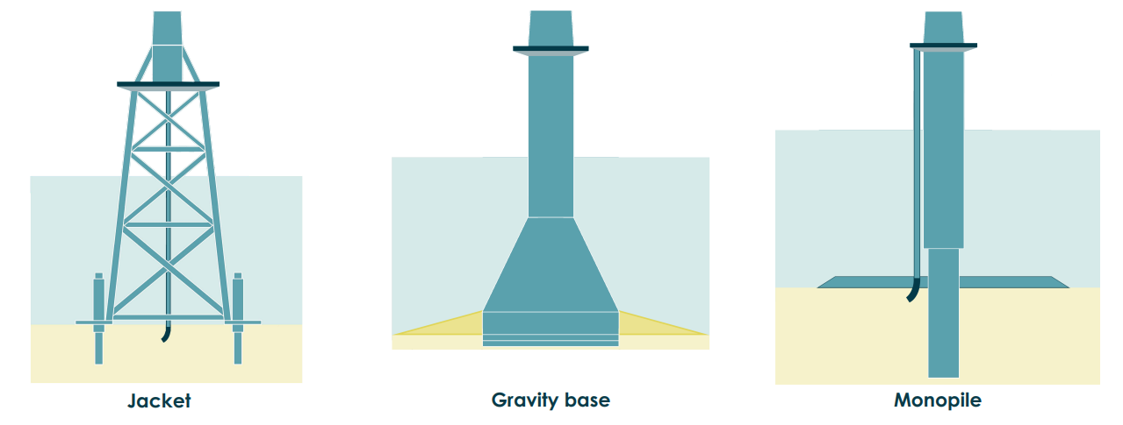
Our
Offshore
Proposal
Inter-Array Cables
Array Area
Offshore Search Zone
Other Windfarms Designated Site
Offshore
Platforms
The offshore elements of The Project consist of an offshore wind turbine array, located approximately 54 km east of the Lincolnshire coast, along with offshore platforms, and export cables and array cables to connect the electricity generated to the National Grid.
Wind Turbine Array Area
The Project design envelope allows for a maximum of 100 wind turbines, with a maximum tip height of 403m LAT (m).
Lincolnshire Node
Export Cables
Typical Foundation Types
Weston Marsh
Notes:
We have just formally entered into our Agreement for Lease with the Crown Estate in January 2023.​
​
The offshore elements of The Project consist of an offshore wind turbine array, located approximately 54 km east of the Lincolnshire coast, along with offshore platforms, inter array cables and export cables to connect the electricity generated to the National Grid. We are not proposing to route our offshore cables down the Wash because of the important international and national designated status – this decision is also reflected by the position of the statutory and non-statutory nature conservation agencies and organizations who have all communicated in very clear terms through the OTNR process and Round 4 Leasing process that no more subsea cables would be supported through the Wash.​
​The Project design envelope allows for a maximum of 100 wind turbines, with a maximum tip height of 403m LAT (Lowest Astronomical Tide). A number of different foundation types are being considered, including monopiles, pin piles, jackets, suction buckets and gravity base foundations. The offshore wind array area currently covers approximately 500 km2 but as part of the ongoing development process, and in consultation with relevant stakeholders, the size of the array area will be refined to 300 km2 prior to construction without any change to overall 1.5GW capacity. The final wind turbine layout will be determined balancing a range of key considerations including wind turbine design, foundation structure, turbine spacing, seabed characteristics, metocean conditions, wind direction, benthic habitats, navigational safety and fisheries considerations, amongst other factors.​
Up to seven offshore platforms may be required for the Project. This includes offshore substation platforms hosting electrical systems to collect the power generated by the wind turbines and export it (through the export cable) to shore, and other platforms including the option to use a reactive compensation platform located along the export cable corridor, or accommodation platforms within the offshore array.​
The offshore export cables from the offshore wind turbines are proposed to make landfall south of Anderby Creek around the Wolla Bank area.​
The offshore route for the export cables has been selected to route south of Triton Knoll to avoid the proposed Silver Pit Highly Protected Marine Area. This route also ensure no crossing of any operational pipelines or cables in the Southern North Sea.​

Slide 6
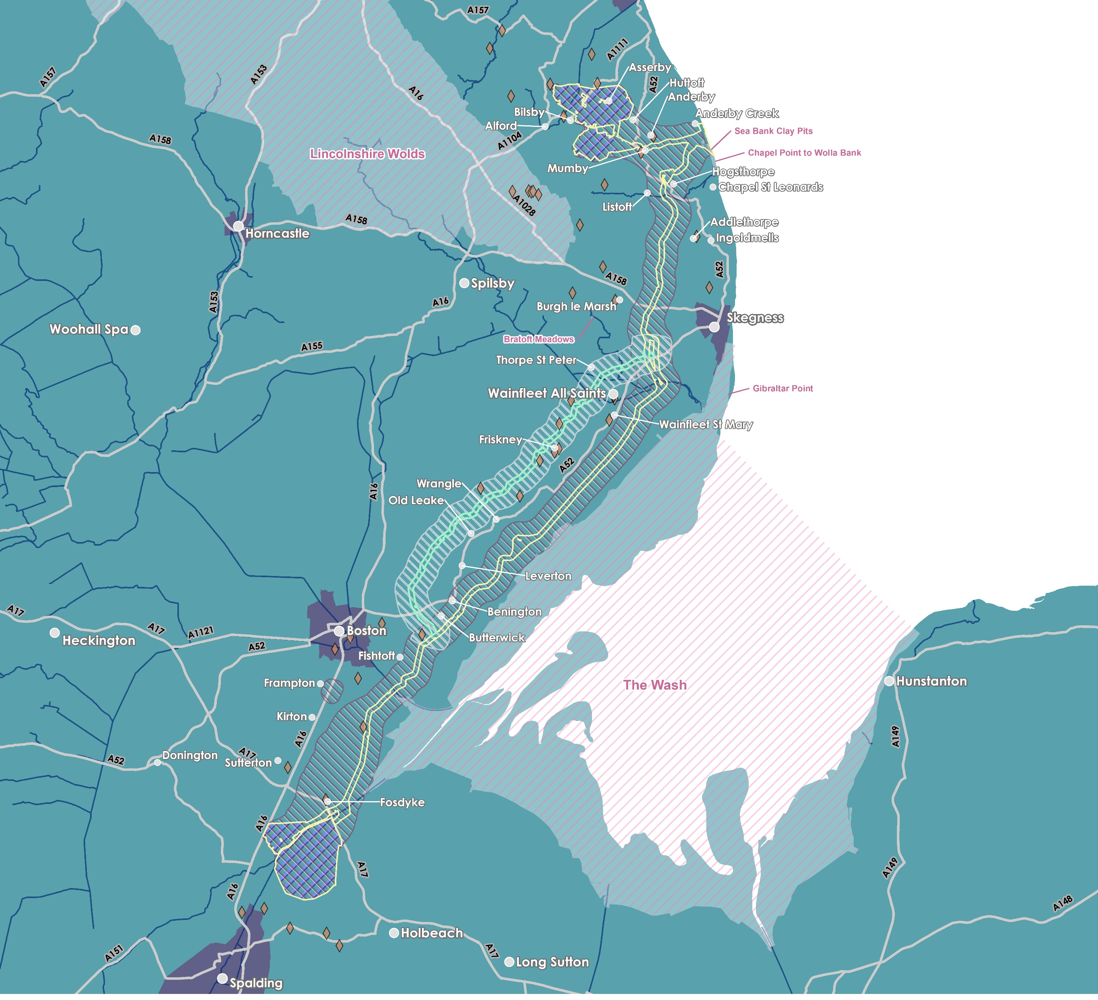
Lincolnshire Node
Our
Onshore
Proposals (& Project update)
Lincs Node Connection Option
New Alternative Route Option to Weston Marsh (north of the A52)
Landfall south of Anderby Creek (there is only one landfall search zone as this has been assessed as the optimum search zone for both connection options);
Underground cables would continue underground to one of two different connection points still under consideration by National Grid;
a connection to the existing overhead line circuits at Weston Marsh (north of Spalding) or;
to a proposed new National Grid connection point, Lincolnshire Node, (east of Alford).
Original Route to Weston Marsh (south of the A52)
Alternative Route Option Search Zone
Alternative Route Option Indicative Cable Corridor
Original Onshore Cable Corridor
Original Onshore Search Zone
Scheduled Monument
Designated Site
Substation Search Zone
Weston Marsh Connection Option
Weston Marsh
Notes:
From the landfall, the cables would continue underground to one of two different connection points which were presented as recommendations under consideration by NG in their report which was published in July earlier this year– a connection to the existing overhead line circuits at Weston Marsh (north of Spalding) or to a proposed new National Grid substation (east of Alford). It’s important to note that one of these connection options will fall away in early new year. ​​
The OTNR Report published in July earlier this year laid out clearly that the option for Outer Dowsing to connect at Lincolnshire Node would be dependent on construction and commissioning of new 400kV overhead lines by National Grid and a new National Grid substation. The development, consenting and construction for any new overhead lines to enable the connection at Lincolnshire Node would be wholly the responsibility for National Grid – plans for this overhead line reinforcement scheme has been around for a number of years before Outer Dowsing was conceived. As a Nationally Significant Infrastructure Project in its own right, any network reinforcement proposals that NGET bring forward would require separate DCO consent and National Grid would be responsible for public consultation and EIA scoping for those.​
The option to connect at Weston Marsh would connect to existing 400kV overhead lines running north of Spalding and could potentially enable an earlier connection date compared to Lincolnshire Node.​
As part of the feedback received during the Phase 1 consultation on our original route, we were made aware of various engineering and environmental considerations potentially affecting the original proposed cable corridor to the Weston Marsh connection option. As a result of this feedback, the Project is considering a proposed amendment to the central section of the onshore cable route option to Weston Marsh (“Alternative Route Option”) as shown on this plan in a brighter green, to the north of the A52. These considerations were Geology (potential for “Running Sands”) Hydrology (high water table) and Agricultural & Farming Practices. Both options are on the table, both routes will be fully assessed in our Preliminary Environmental Information Report (PEIR) and our Phase 2 Consultation will encompass both route options. ​
Once fully assessed the project will make a route selection based upon the full information available and will continue with a single proposed route option. connection option. ​
The Cable corridor is a refined area of search approximately 300m wide for the placement of the onshore underground cables. Whilst the width of the cable corridor may fluctuate along the route to account for specific environmental or engineering constraints, the project will require a typical working corridor of 80m during construction, reducing to a typical 60m wide corridor post construction. The original cable search zone and corridor presented in Phase 1 Consultation Events remain under consideration alongside this alternative route option.​
​
​
​
​
​

Slide 7
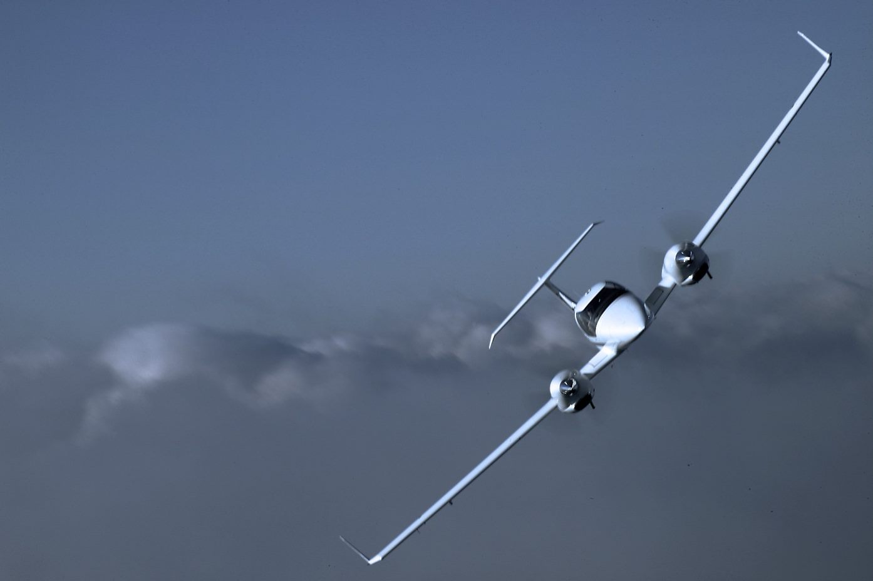
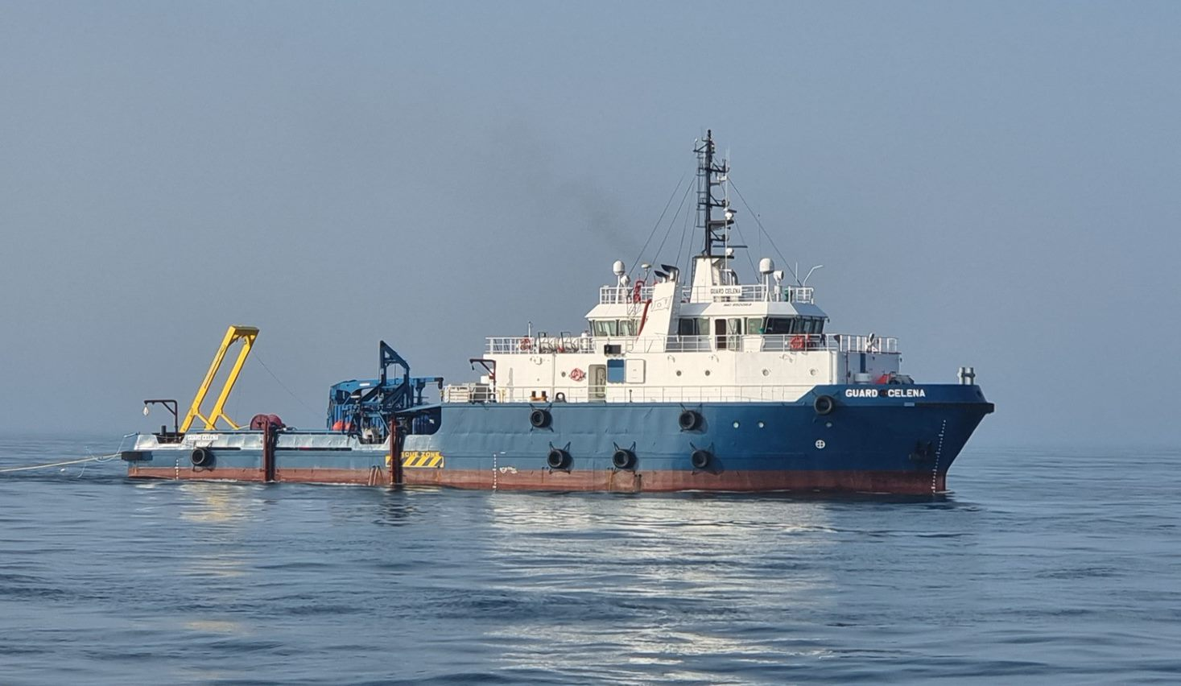
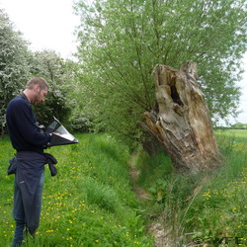
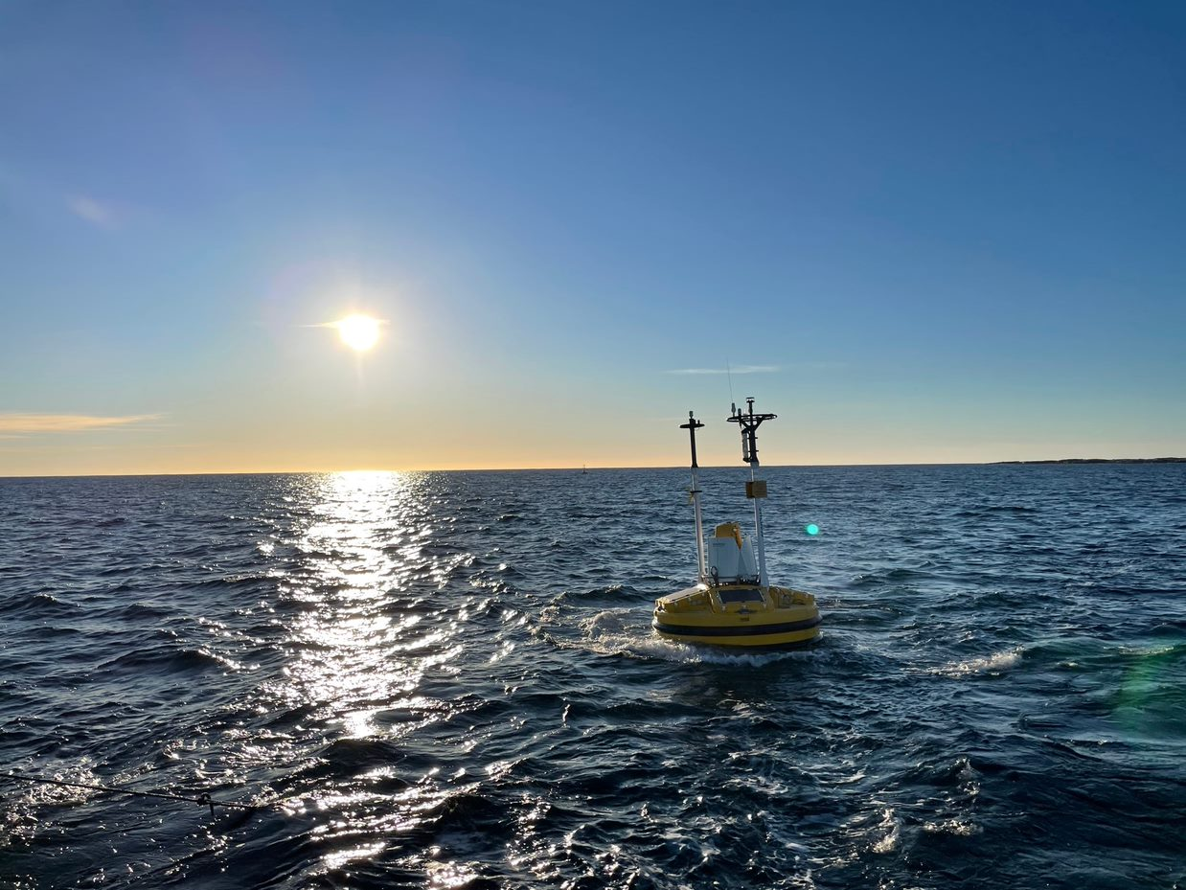
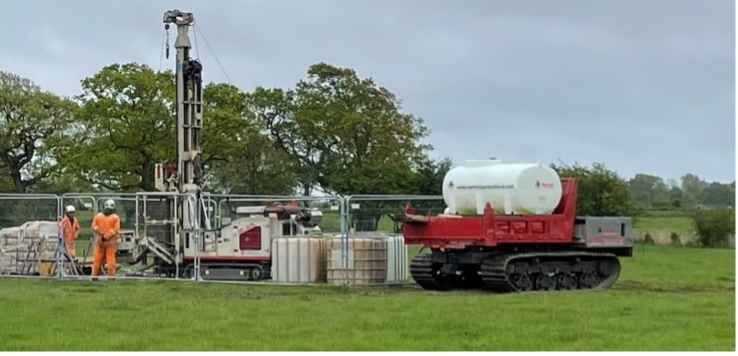
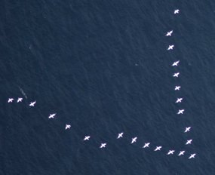
Gathering environmental data
Onshore Surveys
Ornithology – wintering bird surveys
Ecology – Phase 1 Habitat surveys & protected species surveys
Archaeology – geophysical and trial trenching investigations
Engineering – geotechnical, topographical, soil thermal resistivity
Traffic & Transport – traffic counts
Visual – photomontages of substation
Geology & hydrology – flow rates, filtration, drainage
Aerial Photography – Hi-res aerial imagery, vegetation survey and Lidar
Meteorology – weather & climate
Offshore Surveys
Geophysical & Geotechnical
Metocean & wind resource
Ornithology & Marine Mammals
Benthic ecology
Marine Traffic Surveys
Notes:
Having a comprehensive and accurate baseline of environmental and engineering data is critical to the success of our project. We want to ensure that we optimise our design to the site conditions and that we minimise the impact on a wide range of biological, physical and human environmental receptors through sensitive design, mitigation and monitoring. A lot of these surveys go unnoticed, but we invest significant resources through industry leading contractors to acquire data across a wide range of disciplines.
For example, we have just last month completed 2 years of offshore aerial surveys of birds & marine mammals, and also completed last week a high resolution onshore aerial survey of all cable route and substation options. We are looking to undertake a short geotechnical survey campaign from the end of March to ground truth the geology at key locations where we will need to bury our cable deeper under features such as major river channels and at the landfall at Wolla Bank.

Slide 8
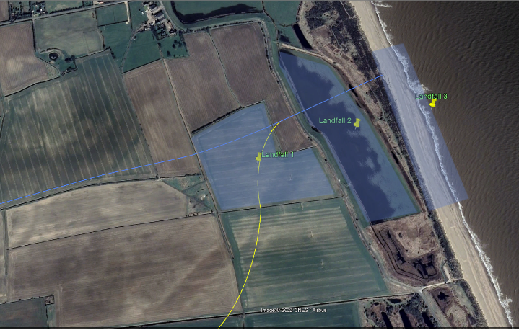
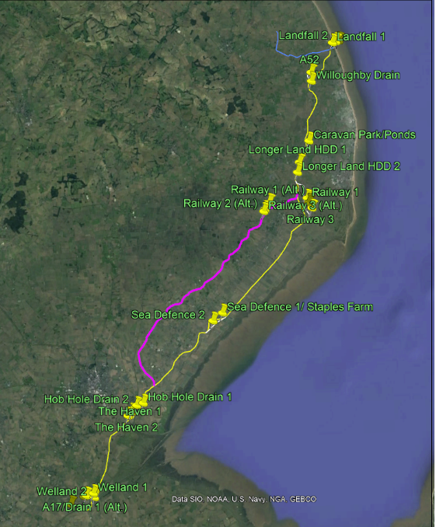
Onshore Geotechnical Survey
Scope
Up to 25 Geotechnical boreholes (15-30m deep)
Trial Pits (3m x 2m)
Cone Penetration Tests (CPTs)
Programme
End March - ~6 weeks
Stakeholder Engagement
Natural England
Lincolnshire Wildlife Trust
The Crown Estate
ELDC, LCC & Parish Councils
Site Notices for beach at Wolla Bank
Access arrangements
Intrusive Survey Licenses from landowners

Slide 9
How are we informing the local community…
Early Launch of Public Exhibition and A1 Maps as requested by residents in response to our Leaflets.
Summarising the Phase 1 feedback & Introduction of the Alternative Route Option.
Formally Introducing the Phase 1A Consultation into the Project’s consultation plan.
5,500 Leaflets issued to all residents in the Phase 1A Consultation Zone.
23,000 Leaflets, 4 in person events (c. 500 attendees) & 2 online webinars.
4 CLG’s established, c.30 attendees.
Phase 1 Consultation
Round 1 CLG’s
ODOW Community Newsletter
Updated SoCC
Phase 1A Consultation publicised
Phase 1A Consultation & Round 2 CLG’s
Landowners on Rev1A notified
Rev 1A Landowner meetings ongoing
Nov 2022
Nov/ Dec 2022
Early Jan 2023
Late Jan 2023
Early Feb 2023
Late Feb 2023
Collation of Feedback from Phase 1 Consultation
In depth assessment and further Route analysis work…
Introduction of Route “Rev 1A” into the Project
Ongoing Surveys to collect Baseline information for the PEIR.

Slide 10
Lincs Node Substation Search Zone
Our Onshore Substation(s) Search Zones
Until we have secured a final grid connection, we currently have two search zones for the onshore substation & associated infrastructure required to connect to the National Grid transmission system.
Weston Marsh connection option
Here there would be the Outer Dowsing substation & a National Grid Customer Substation. Some overhead line modifications will be required at, or near to, the ODOW/National Grid substation(s) to facilitate the connection of our project at this location.
  Lincolnshire Node connection option
  Here there would be the Outer Dowsing substation & we would be connected to the planned National Grid wider reinforcement works, this is likely to require a larger footprint, however the details of these plans are not yet known.
At this stage it is difficult to know exactly what the substation(s) will look like due to the number of unknowns, however the Phase 2 Consultation phases will include Visualisations of theoretical Worst-Case Scenario’s and we will use feedback from this to help inform the aspects of the design that will go into the Application.
As well as this we are proposing to establish an “Onshore Substation Working Group”, we aim to establish this as soon as a grid connection for the Project is confirmed and we can progress the designs for the onshore substation in consultation with the community who are local to it! What do you think?
Weston Marsh Substation(s) Search Zone
Notes:
Until we have secured a final grid connection, we currently have two search zones for the onshore substation & associated infrastructure required to connect to the National Grid transmission system. Only one of these zones, along with the associated onshore cable route will be progressed once a final connection point is confirmed.​
​
For the Weston Marsh connection option (in the south), the overall footprint of substation works for Outer Dowsing and the National Grid enabling works required to connect to the existing National Grid transmission system is anticipated to have a maximum footprint of 9.2 hectares for the operational substation footprint and 18 hectares for the total land take to include mitigation and drainage. Some overhead line modifications will be required at, or near to, the ODOW/National Grid substation(s) to facilitate the connection of our project at this location.​
​
For the Lincolnshire Node connection option (in the north), the combination of the Outer Dowsing substation and the planned National Grid wider reinforcement works is likely to require a larger footprint, however the details of these plans are not yet known.​
​
Further detail on works required to connect the project to the National Grid transmission system are anticipated to be available upon conclusion of the OTNR process, including information on what aspects of the required National Grid works would be included in the Outer Dowsing DCO application.

Slide 11






Landfall
The cables at the Landfall at Anderby Creek will be facilitated through the use of horizontal directional drilling (HDD) to install ducts within which the offshore power cables can be installed and joined to the onshore cables at a transition joint bay onshore.
What does this mean? This means that the project will be drilling underneath the beach, the dunes, Anderby Marsh LNR and the coastal (Roman Bank) road .. The drill compound will be located on the western side of the coastal road (Roman Bank), ensuring minimal interaction with the beach and the Coastal Country Park.
We are consulting with the below Nature Conservation Bodies and organisations to see how we can achieve Biodiversity Net Gain as part of our project, ensuring our efforts are put to work locally and that our project has minimal adverse impacts, and the overall outcome is positive with maximum gain for the local area.
We want to learn and work together to ensure we develop our proposals for the landfall in the best way we can, minimising disturbance and impacts to the communities as much as possible and possibly even working together to achieve the biodiversity ambitions of the Coastal Country Park.

Slide 12
What have we been doing?
Key Feedback and Our Response
Experiences from Viking Link & Triton Knoll:
  Update: We are reviewing the experiences on both Triton Knoll and Viking Link. We are also ensuring that all feedback from the community is fed back to our technical teams and discussed as part of our Expert Technical Groups (ETG’s) with all relevant stakeholders.
Grid connection Location (Lincs Node or Weston Marsh)
  Update: We have been having regular meeting with National Grid and we have been advised we should be getting a confirmed grid connection offer by Spring.
Concerns on Original Route to Weston Marsh (Agricultural Practices, “Running Sands” and High water table)
  Update: Introduction to the Project Design Envelope of an Alternative Route Option, that avoids the majority of this area without significantly impacting the cost of delivery (i.e. increasing the length of the cable route by a significant margin).
Temporary impact on agriculture & restoration
  Update: We have met with over 300 landowners and established Landowner Interest Groups.
Archaeology (The Salterns)
  Update: We have been meeting with the County Council Archaeologist to discuss the results of our desk-based assessment and proposed approach to non-intrusive surveys through 2023.
Community benefit engagement and Biodiversity Net Gain
  Update: We have been meeting with a number of key stakeholders to discuss potential collaborations from both a Community and Biodiversity Perspective.
Useful information & feedback for substation search zones
  Update: We are progressing with some visualisations for our Phase 2 Consultation for some specific candidate substation sites and configurations. We want to be as transparent as possible with the community and get their feedback on these options.
Concerns for cumulative impacts for future projects – planning coordination
  Update: We are regularly updating our planning system to ensure any known projects are included in our Cumulative impact Assessment.

Slide 13
Q&A
Thanks for joining us this evening! We really appreciate your time and feedback.

