Slide 1


Outer Dowsing Offshore Wind
Community Liaison Group
Q4 2022

Slide 2

Agenda
Outer Dowsing Offshore Wind - CLG
Item: |  | Timing (approx.)
1 | Coffee and tea | 10 mins​
2 | Chair’s welcome and introductions | 10 mins​
3 | Aims and Terms of Reference | 10 mins​
4 | Project Overview | 10 mins​
5 | Issues raised at Project Information Days / webinars | 20 mins​
4 | Question and answer session / discussion on future topics | 20 mins​
5 | AOB | 5 mins​
6 | Chair’s closing remarks and next steps / next meeting | 5 mins​
Notes:
This is our first phase of our consultation - our project launch – so we are hear to give you a relatively high overview of our proposals and to listen to your views. As a Nationally Significant Infrastructure Project, we will have further statutory consultation next year, and there will be plenty of further opportunities to get involved with our project both during pre-application and during the Examination process when our DCO application will be put under further scrutiny.
We want to put communities and environment at the forefront of our Project – which will be at least 54km offshore. For context, the nearest turbine of the recently constructed Triton Knoll project is 35km offshore from Anderby Creek. We are directly behind, or east of, Triton Knoll at a minimum of 54km, so the majority of the turbine structures will be well over the horizon and only visible for 2% of the year.
Who are we? The project is being developed in a joint venture between Corio Generation and TotalEnergies.
TotalEnergies is a hugely ambitious company which aims to rank among the top five global producers of solar and wind generated electricity by 2030. In the past four years, the Company's gross installed capacity for renewable power grew from 0.7 GW in 2017 to more than 10 GW in 2021. The objective is to have 35 GW of gross capacity in 2025 and 100 GW in 2030. Over 30% of total investments is now devoted to decarbonized energy. The total capacity of our portfolio of offshore wind projects exceeds 10 GW.
Corio Generation is a Macquarie Green Investment Group portfolio company, operating on a standalone basis. We’re a specialist offshore wind business, dedicated to harnessing renewable energy worldwide. With over 11GW of operational projects and over 20GW in development. The UK, the Green Investment Group has supported almost 50 per cent of the existing offshore wind projects in operation.

Slide 3
1. Terms of Reference (ToR’s) & Aims
Our Aims …
To involve key local stakeholders in the design and development of the Outer Dowsing Offshore Wind project (landfall, onshore cable route and substation) through presentations, discussions and planned workshop activities.
To act as a two-way communication channel between local communities and the project team.
To help foster local involvement and ownership of the project.
Any comments or Queries on the group Aims or ToR’s as circulated prior to this meeting?
To facilitate focused discussions and ensure attendees can make the most out of the CLG’s – it is intended for these groups to be focused on concerns/ issues / thoughts relative to their specific local area.
In the case of Anderby, this comprises:
Landfall
Northern substation search area
Northern section of the cable route
Notes:
Good afternoon / evening - My name is Chris Jenner, the Development Manager for the Outer Dowsing Offshore Wind Farm and I would like to welcome you to this online webinar.
Before we run through the slides, a few housekeeping points…..
I anticipate spending 30 minutes or so running through the slides, followed by an opportunity for the Outer Dowsing team to answer some of your questions.
We are recording this for the purposes of having a record of consultation – But for those of you who have not attended one of these webinars before, all public attendees will automatically have their cameras off & microphones on mute.
You should see a Q&A section on the right hand side of your screen, and/or a Q&A button on the top of your window which should toggle on the Q&A panel if you can’t see it. At anytime, you can type in a question and we will endeavour at the end of the presentation to answer as many questions as we can. For the sake of good order, we do have a moderator who will be able to screen any unsuitable questions, so we do ask that you keep your questions as factual as possible and to the point.
Other members of the Outer Dowsing team & some advisors are also on this webinar - and I will bring them into the Q&A session if required to answer any specific technical questions. If we don’t manage to answer your questions, please send to our contact email address on this screen and/or do complete an online questionnaire/feedback form available on our website at www.outerdowsing.com. Links to both will be sent to all email addresses who opted in when registering for this webinar.
We are hosting both physical and online events to try and reach as many people as possible…….across East Lindsey, Boston and South Holland with the aim informing you of our proposals and listening to your comments, feedback and thoughts. The slides I am about to talk through reflect the content of the exhibition panels that are on display at the walk in events at the village halls – our first was held in Anderby Creek on 1st Nov on Tuesday, with future walk in events to be held at Wainfleet on Friday 4th Nov, at Fosdyke on Saturday 5th Nov and lastly at Butterwick on Friday 11th Nov.
And finally, before I launch into the slides, a little bit about me - I have been involved developing and building projects off the Humber for nearly 20 years – I remember setting up the first office in Grimsby for the Lynn & Inner Dowsing project and have witnessed first hand the transformation as the Humber region has grown into one of the offshore wind capitals of the world providing Through my involvement in a similar role for the Hornsea projects for 5 years, I witnessed first hand as Siemens invested into the region and I am proud to continue my involvement with the Humber region & Lincolnshire to provide further employment & supply chain opportunities with this next generation 4th Leasing Round project being developed by Corio Generation and TotalEnrgies. We have brought together an exceptional team that can draw on decades of experience to ensure Outer Dowsing represents an evolution of best practice development and construction.

Slide 4
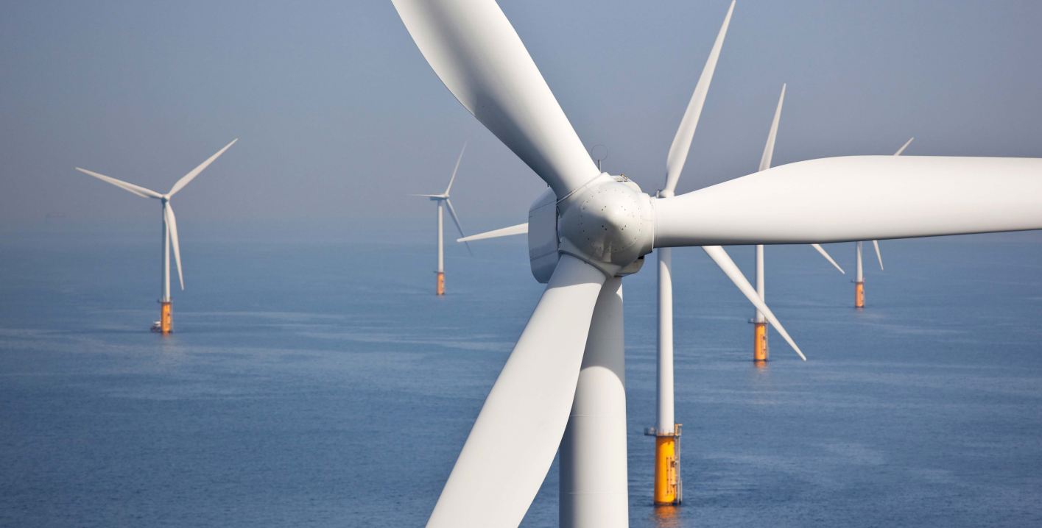


Welcome
Outer Dowsing Offshore Wind
Welcome to the our very first Community Liaison Group. Thank you very much for joining us and we look forward to working with you all as we develop this project!
A little reminder of who we are…
The Project is a proposed offshore windfarm located approximately 54 kilometres off the coast of Lincolnshire, England.
The project comprises of a 1.5 GW offshore generating station, and offshore and onshore transmission infrastructure. Outer Dowsing Offshore Wind is being developed by Corio Generation (a wholly-owned Green Investment Group portfolio company) and TotalEnergies.

Slide 5
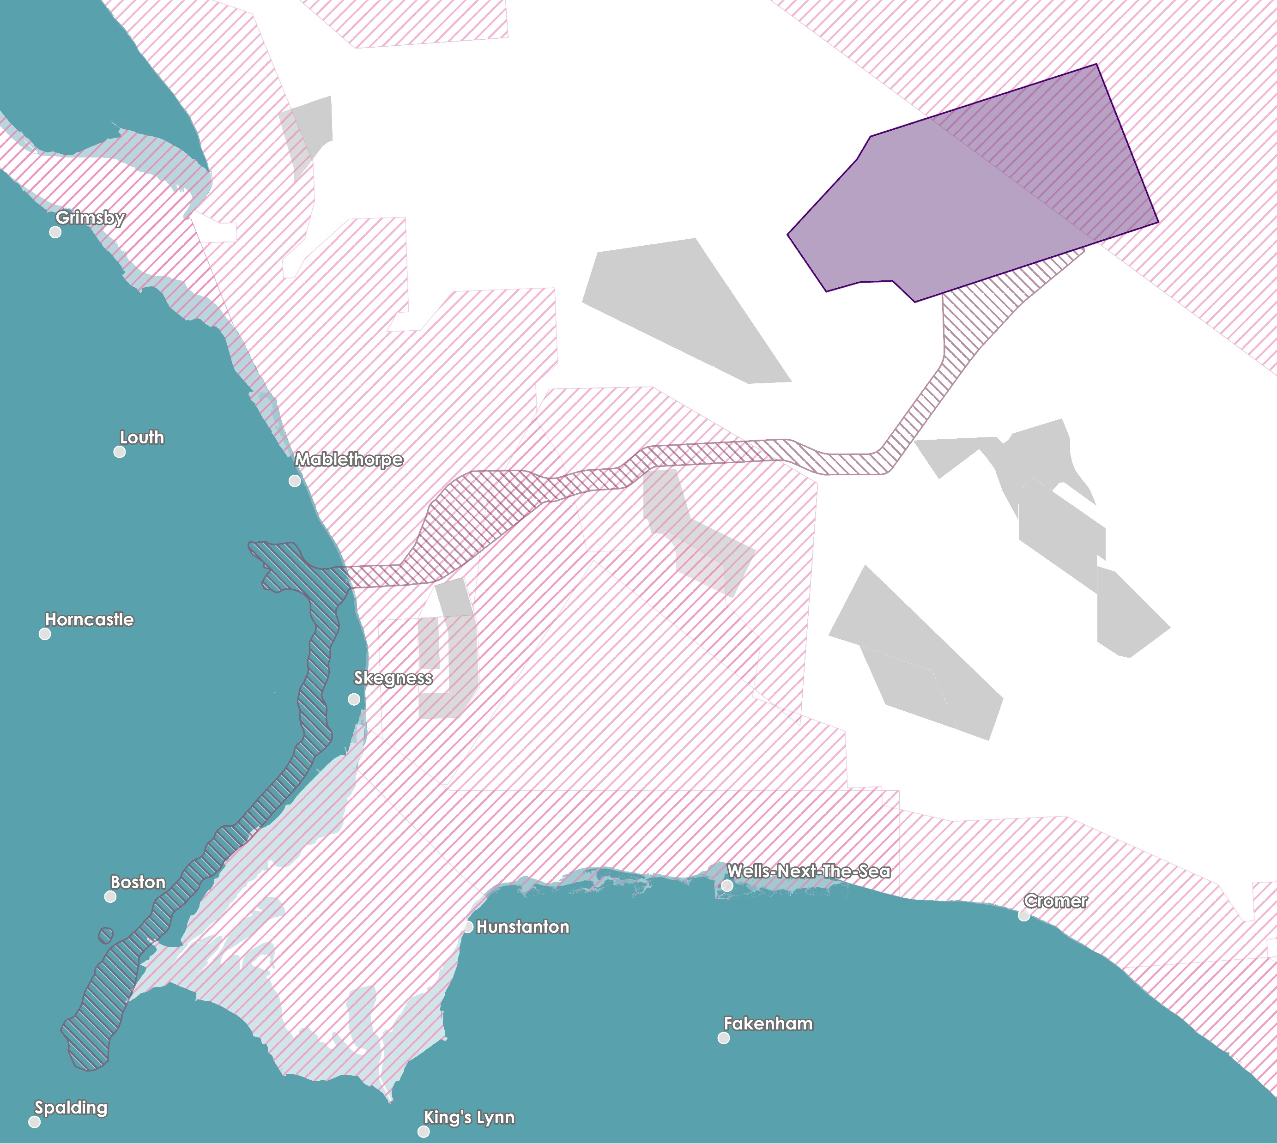

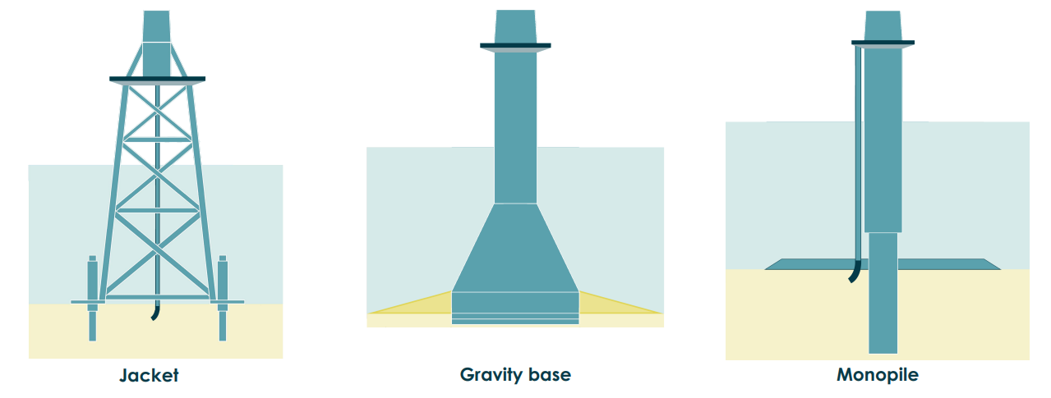
Our
Offshore
Proposal
Inter-Array Cables
Array Area
Offshore Search Zone
Other Windfarms Designated Site
Offshore
Platforms
The offshore elements of The Project consist of an offshore wind turbine array, located approximately 54 km east of the Lincolnshire coast, along with offshore platforms, and export cables and array cables to connect the electricity generated to the National Grid.
Wind Turbine Array Area
The Project design envelope allows for a maximum of 100 wind turbines, with a maximum tip height of 403m LAT (m).
Lincolnshire Node
Export Cables
Typical Foundation Types
Weston Marsh
Notes:
The offshore elements of The Project consist of an offshore wind turbine array, located approximately 54 km east of the Lincolnshire coast, along with offshore platforms, inter array cables and export cables to connect the electricity generated to the National Grid. We are not proposing to route our offshore cables down the Wash because of the important international and national designated status – this decision is also reflected by the position of the statutory and non-statutory nature conservation agencies and organizations who have all communicated in very clear terms through the OTNR process and Round 4 Leasing process that no more subsea cables would be supported through the Wash.
The Project design envelope allows for a maximum of 100 wind turbines, with a maximum tip height of 403m LAT (Lowest Astronomical Tide). A number of different foundation types are being considered, including monopiles, pin piles, jackets, suction buckets and gravity base foundations. The offshore wind array area currently covers approximately 500 km2 but as part of the ongoing development process, and in consultation with relevant stakeholders, the size of the array area will be refined to 300 km2 prior to construction without any change to overall 1.5GW capacity. The final wind turbine layout will be determined balancinga range of key considerations including wind turbine design, foundation structure, turbine spacing, seabed characteristics, metocean conditions, wind direction, benthic habitats, navigational safety and fisheries considerations, amongst other factors.
Up to seven offshore platforms may be required for the Project. This includes offshore substation platforms hosting electrical systems to collect the power generated by the wind turbines and export it (through the export cable) to shore, and other platforms including the option to use a reactive compensation platform located along the export cable corridor, or accommodation platforms within the offshore array.
The offshore export cables from the offshore wind turbines are proposed to make landfall south of Anderby Creek around the Wolla Bank area.
The offshore route for the export cables has been selected to route south of Triton Knoll to avoid the proposed Silver Pit Highly Protected Marine Area. This route also ensure no crossing of any operational pipelines or cables in the Southern North Sea.

Slide 6
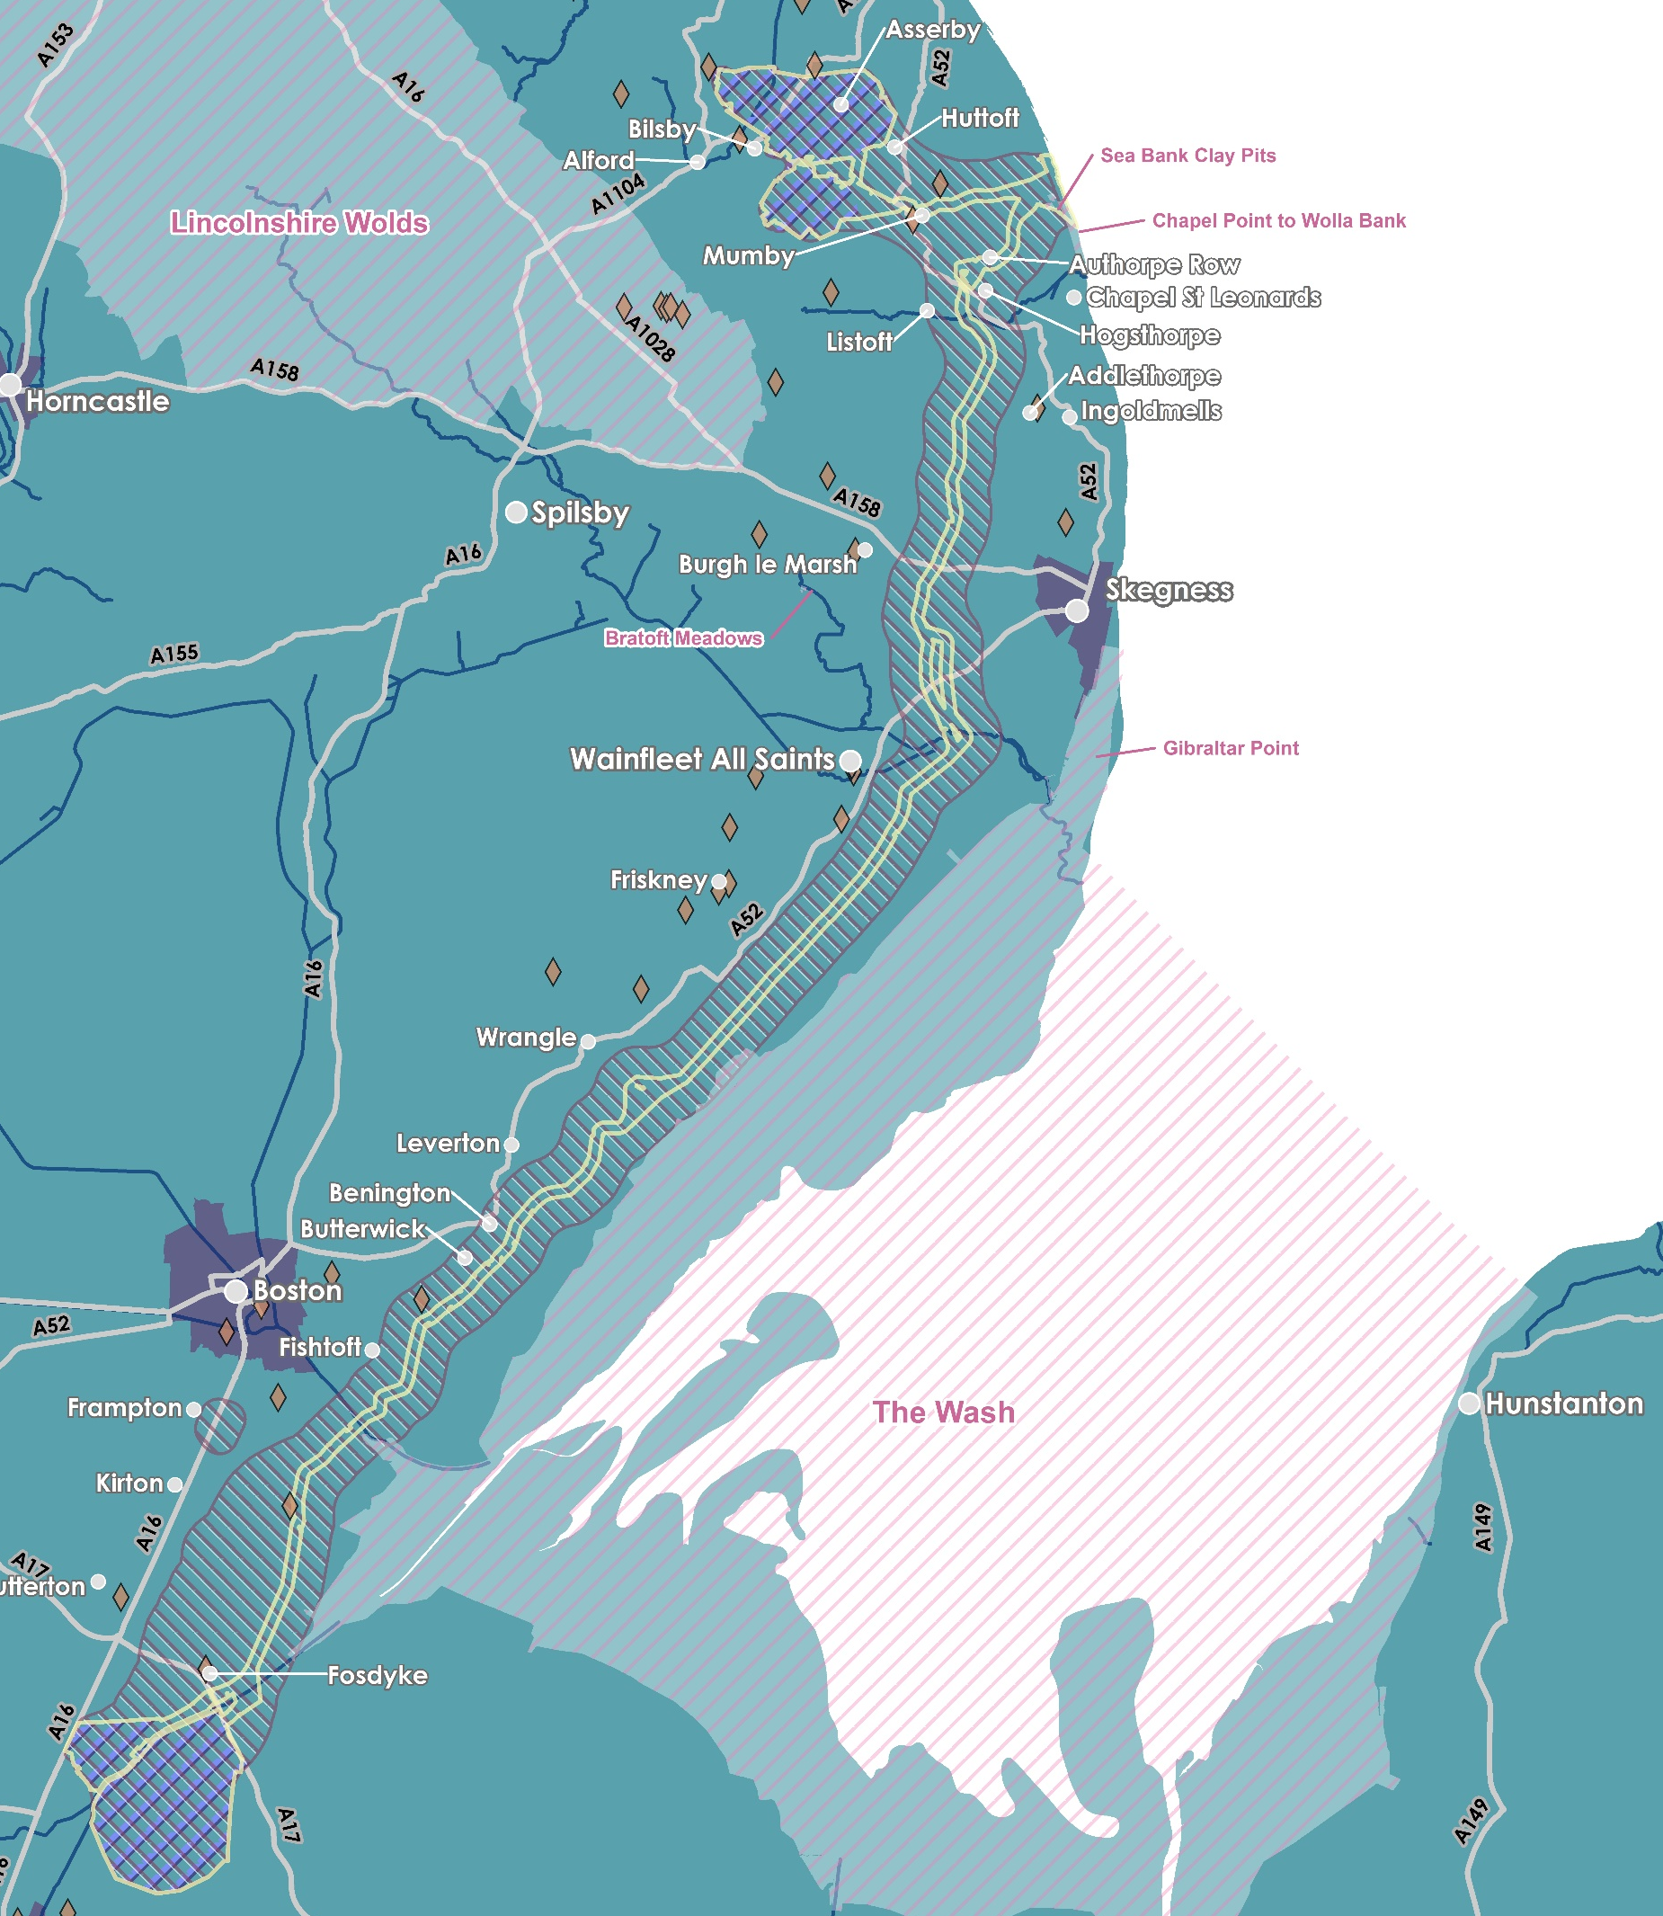
Lincolnshire Node
Our
Onshore
Proposals
Landfall south of Anderby Creek;
Undergound cables would continue underground to one of two different connection points still under consideration by National Grid;
a connection to the existing overhead line circuits at Weston Marsh (north of Spalding) or;
to a proposed new National Grid substation, Lincolnshire Node, (east of Alford).
Onshore Cable Corridor
Onshore Search Zone
Substation Search Zone
Scheduled Monument
Designated Site
Weston Marsh
Notes:
From the landfall, the cables would continue underground to one of two different connection points which were presented as recommendations under consideration by NG in their report which was published in July earlier this year– a connection to the existing overhead line circuits at Weston Marsh (north of Spalding) or to a proposed new National Grid substation (east of Alford). It’s important to note that one of these options will fall away in early new year.
The OTNR Report published in July earlier this year laid out clearly that the option for Outer Dowsing to connect at Lincolnshire Node would be dependent on construction and commissioning of new 400kV overhead lines by National Grid and a new National Grid substation. The development, consenting and construction for any new overhead lines to enable the connection at Lincolnshire Node would be wholly the responsibility for National Grid – plans for this overhead line reinforcement scheme has been around for a number of years before Outer Dowsing was conceived. As a Nationally Significant Infrastructure Project in its own right, any network reinforcement proposals that NGET bring forward would require separate DCO consent and National Grid would be responsible for public consultation and EIA scoping for those.
The option to connect at Weston Marsh would connect to existing 400kV overhead lines running north of Spalding and could potentially enable an earlier connection date compared to Lincolnshire Node.
Some terminology:
Landfall Search Zone: The landfall search zone has been selected through environmental and technical assessments. There is only one landfall search zone as this has been assessed as the optimum search zone for both connection options.
Onshore Cables Search Zone: Using the same environmental and technical appraisal approach, we assessed a wide study area presented in our Scoping Report in July 2022 and are presenting the onshore cable search zone and onshore substation search zones in order to seek your feedback to help shape our proposals.
Onshore Substations Search Zones: Until we have secured a final grid connection, we currently have two search zones for our new onshore substation (Lincolnshire Node and Weston Marsh). Only one of these zones, along with the accompanying onshore cable route search zone will be progressed once a final connection point is adopted, with a decision from National Grid anticipated to be early next year. The substation site is anticipated to have a maximum footprint of 9.2 hectares for the operational substation footprint and 18 hectares for the total land take including mitigation and drainage. We will bring forward more detailed design and location plans for a substation when National Grid have concluded their appraisal to determine our connection point early next year, but at this stage we are seeking feedback on the substation search zones identified in this plan identified with double cross hatching.
Onshore Cable Corridor: The cable corridor is a refined area of search (c. 300m wide) in which the route of the onshore cables are currently proposed to be located. During construction this route will have a typical 80m construction working width. Following further survey work, environmental and technical assessments, and feedback from the local community and stakeholders, the optimum cable route will be adopted for the DCO Application. On completion this will be reduced to a 60m underground permanent easement.

Slide 7
Landfall
What is landfall?
Landfall is the location along the project cable route where the offshore transmission cables carrying power from the wind turbines are brought ashore and link to the onshore cables. Following an extensive site selection process and landfall assessment, the optimum location for the landfall for Outer Dowsing Offshore Wind sits just south of Anderby Creek.
Landfall will be facilitated through the use of horizontal directional drilling (HDD) to install ducts within which the offshore power cables can be installed and joined to the onshore cables at a transition joint bay onshore. This method is a proven technique and has been applied as common practice throughout the industry for landfall of offshore wind projects amongst other applications.
What does this mean?
This means that the project will be drilling underneath both the beach, the dunes, Anderby Mash LNR and the road .. The drill compound will be located on the western side of the coastal road (Roman Bank), ensuring minimal interaction with the beach and the Coastal Country Park.
We appreciate we are not the first project to undertake works like this in your local area, we are therefore keen to hear any feedback you have on any issues from yourselves or your constituents who might have experienced this work in the past. We want to learn and work together to ensure we develop our proposals for the landfall in the best way we can, minimising disturbance and impacts to the communities as much as possible and possibly even working together to achieve the biodiversity ambitions of the Coastal Country Park.
Notes:
From the landfall, the cables would continue underground to one of two different connection points which were presented as recommendations under consideration by NG in their report which was published in July earlier this year– a connection to the existing overhead line circuits at Weston Marsh (north of Spalding) or to a proposed new National Grid substation (east of Alford). It’s important to note that one of these options will fall away in early new year.
The OTNR Report published in July earlier this year laid out clearly that the option for Outer Dowsing to connect at Lincolnshire Node would be dependent on construction and commissioning of new 400kV overhead lines by National Grid and a new National Grid substation. The development, consenting and construction for any new overhead lines to enable the connection at Lincolnshire Node would be wholly the responsibility for National Grid – plans for this overhead line reinforcement scheme has been around for a number of years before Outer Dowsing was conceived. As a Nationally Significant Infrastructure Project in its own right, any network reinforcement proposals that NGET bring forward would require separate DCO consent and National Grid would be responsible for public consultation and EIA scoping for those.
The option to connect at Weston Marsh would connect to existing 400kV overhead lines running north of Spalding and could potentially enable an earlier connection date compared to Lincolnshire Node.
Some terminology:
Landfall Search Zone: The landfall search zone has been selected through environmental and technical assessments. There is only one landfall search zone as this has been assessed as the optimum search zone for both connection options.
Onshore Cables Search Zone: Using the same environmental and technical appraisal approach, we assessed a wide study area presented in our Scoping Report in July 2022 and are presenting the onshore cable search zone and onshore substation search zones in order to seek your feedback to help shape our proposals.
Onshore Substations Search Zones: Until we have secured a final grid connection, we currently have two search zones for our new onshore substation (Lincolnshire Node and Weston Marsh). Only one of these zones, along with the accompanying onshore cable route search zone will be progressed once a final connection point is adopted, with a decision from National Grid anticipated to be early next year. The substation site is anticipated to have a maximum footprint of 9.2 hectares for the operational substation footprint and 18 hectares for the total land take including mitigation and drainage. We will bring forward more detailed design and location plans for a substation when National Grid have concluded their appraisal to determine our connection point early next year, but at this stage we are seeking feedback on the substation search zones identified in this plan identified with double cross hatching.
Onshore Cable Corridor: The cable corridor is a refined area of search (c. 300m wide) in which the route of the onshore cables are currently proposed to be located. During construction this route will have a typical 80m construction working width. Following further survey work, environmental and technical assessments, and feedback from the local community and stakeholders, the optimum cable route will be adopted for the DCO Application. On completion this will be reduced to a 60m underground permanent easement.

Slide 8
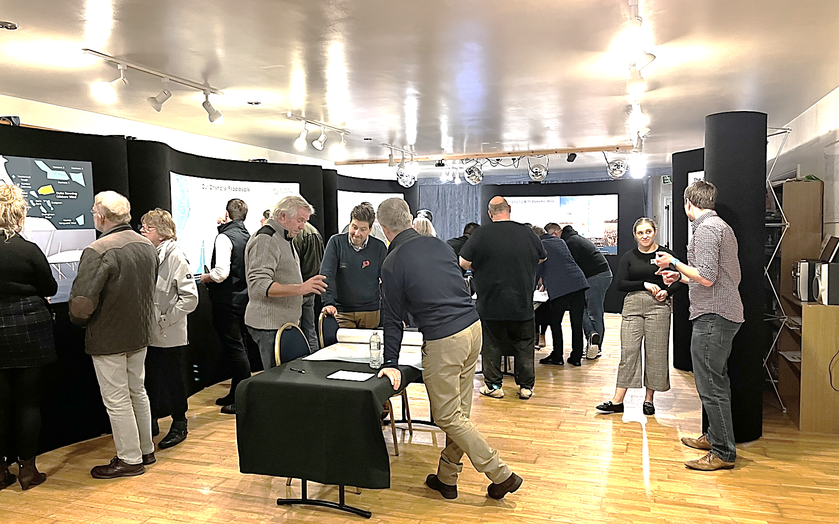
Our Phase 1 Consultation Events

Slide 9
What did we learn?
Energy security a key issue
Lots of shared experiences (good & bad) from Viking & Triton Knoll, the following issues noted:
  Chopping down of trees for access turning points
  Dust
  Traffic & Air Quality
    (in particular the 40mph temporary zones in place 24/7)
    Limit to HGVs through Boston - air quality
Grid connection options - views vary depending on location of attendees
Constraint to expansion of economic development from lack of grid availability
Useful information & feedback for substation search zones
Concerns for cumulative impacts for future projects – planning coordination
Interface with National Grid wider works - trigger points
Temporary impact on agriculture & restoration.
Archaeology
  The Salterns
Ecology and ornithology
  The coastal communities of Lincolnshire have an inspiring fondness for nature
  We want to encourage, support and foster this.. how can we get involved?
Community benefit engagement and Biodiversity Net Gain

Slide 10
Q&A
Thanks for joining us this evening! We really appreciate your time and feedback.
Notes:
Thank you for listening today.
We will now try to answer some of your questions. If you haven’t already, please write your question down in the webinar “chat” area.
If we don’t get a chance to answer your question today, please submit your question to:
contact@outerdowsing.com
..and we will contact you directly

