Slide 1

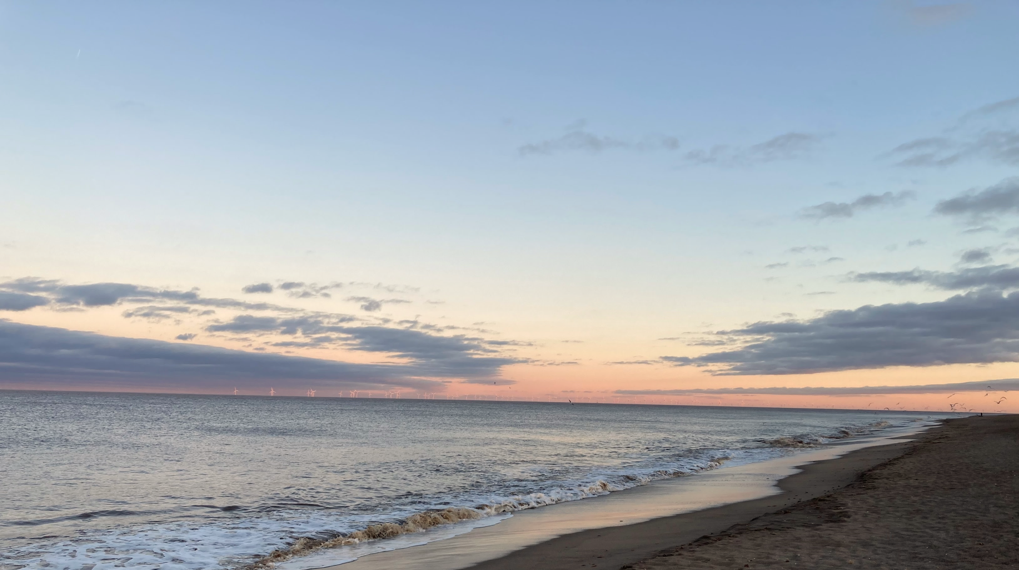

Outer Dowsing Offshore Wind
Community Liaison Group
April 2023

Slide 2

Agenda
Outer Dowsing Offshore Wind - CLG
Item: |  | Timing (approx.)
1 | Coffee and tea | 10 mins​
2 | Chair’s welcome and introductions | 5 mins​
3 | Project Update | 5 mins​
4 | Presentation of onshore substation design option | 25 mins​
5 | Consultation next steps | 10 mins​
4 | Question and answer session / discussion on future topics | 5 mins​
5 | AOB | 5 mins​
6 | Chair’s closing remarks and next steps / next meeting | 5 mins​

Slide 3
A quick reminder of what we hope to achieve with these Community Liaison Groups…
Our Aims …
To involve key local stakeholders in the design and development of the Outer Dowsing Offshore Wind project (landfall, onshore cable route and substation) through presentations, discussions and planned workshop activities.
To act as a two-way communication channel between local communities and the project team.
To help foster local involvement and ownership of the project.
To facilitate focused discussions and ensure attendees can make the most out of the CLG’s – it is intended for these groups to be focused on concerns/ issues / thoughts relative to their specific local area.

Slide 4



The Project Partners
Outer Dowsing Offshore Wind is being developed jointly by TotalEnergies, Corio Generation (part of the Green Investment Group) and Gulf Energy
TotalEnergies is a global multi-energy company that produces and markets energies: oil and biofuels, natural gas and green gases, renewables and electricity.
It’s over 100,000 employees are committed to energy that is ever more affordable, cleaner, more reliable and accessible to as many people as possible. Active in more than 130 countries, TotalEnergies puts sustainable development in all its dimensions at the heart of its projects and operations to contribute to the well-being of people.
Corio Generation is a Green Investment Group (GIG) portfolio company, operating on a standalone basis. GIG is a specialist green investor within Macquarie Asset Management, part of Macquarie Group.
With a unique blend of sector-leading expertise and deep access to long-term capital, Corio Generation applies a long-term partnership approach to the creation and management of projects, taking them from origination, through development and construction, and into operations.
Gulf Energy Development (GULF) is a holding company based in Thailand that invests in a portfolio of energy, infrastructure, and digital and telecommunications businesses.
As one of Thailand's largest private power producers with over 20 GW of gas-fired and renewable capacity, GULF is committed to supporting the energy transition to create sustainable shared value in all spheres where it operates.

Slide 5
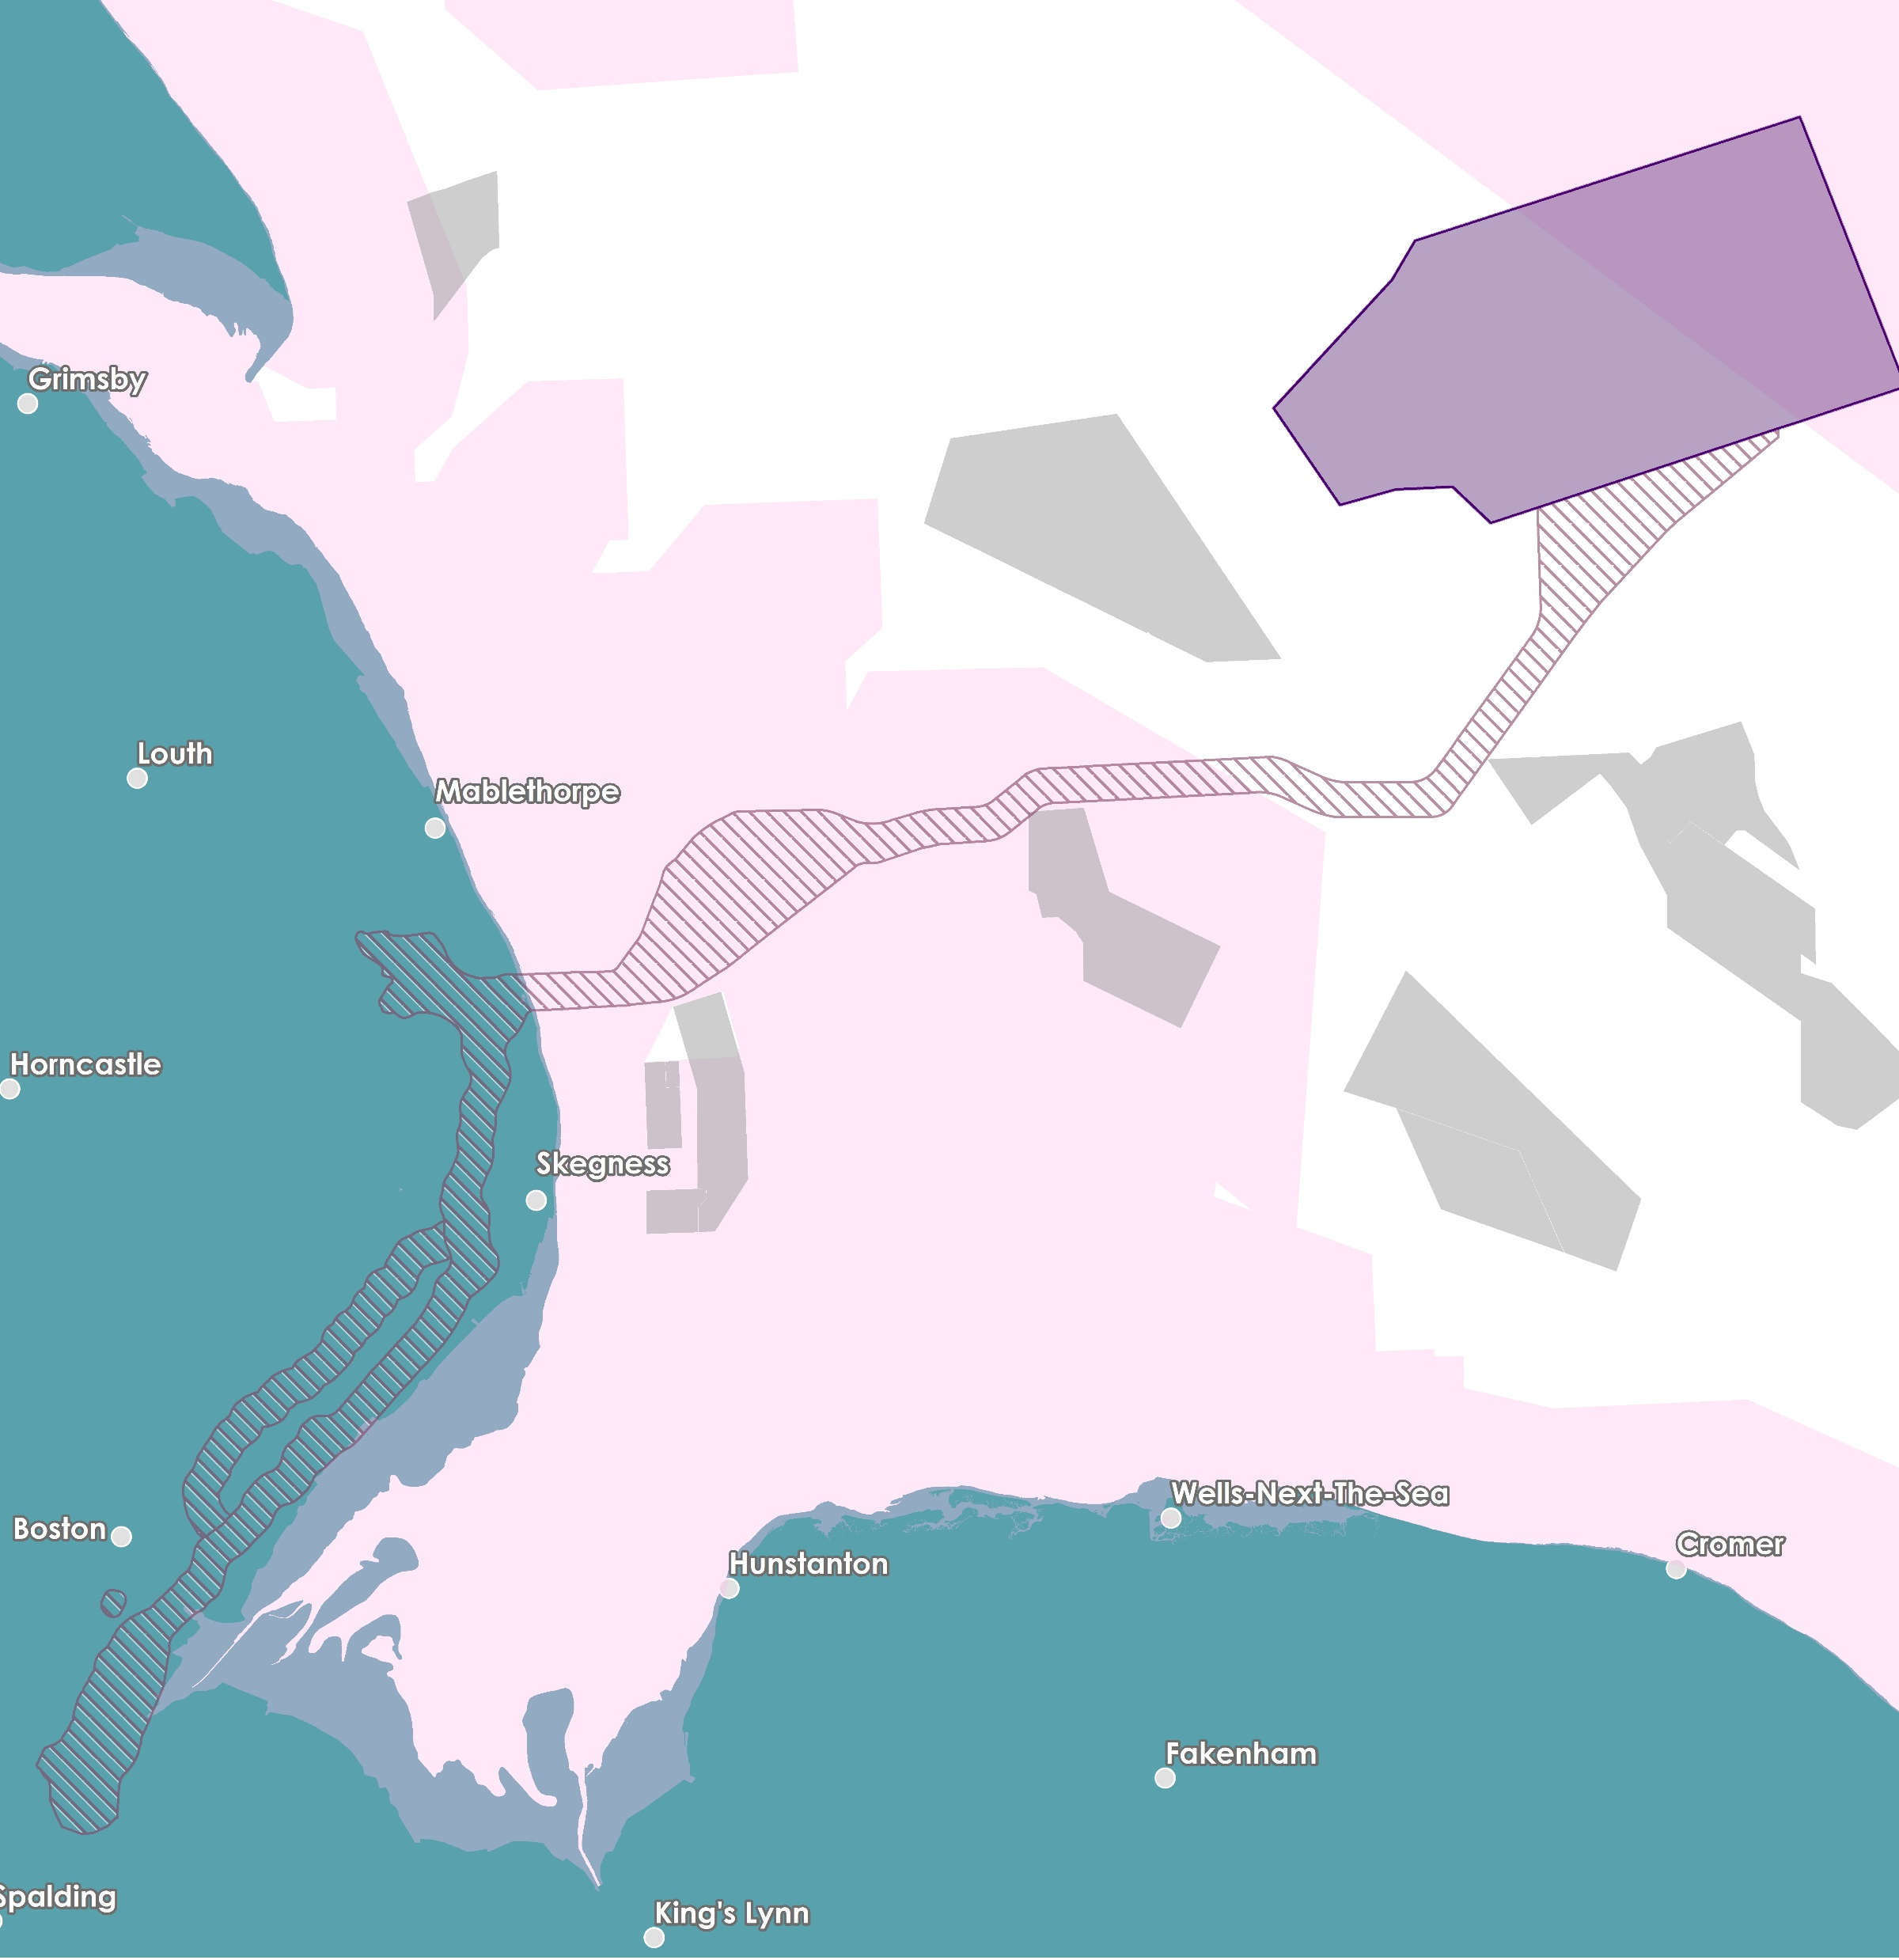

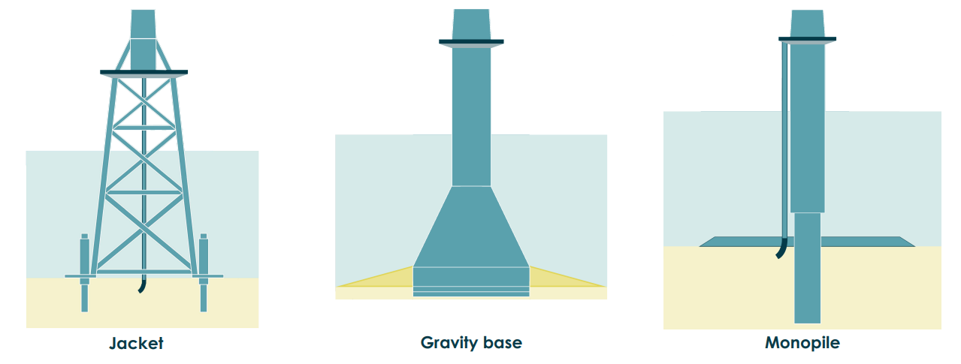
Our
Offshore
Proposal
Inter-Array Cables
Array Area
Offshore Search Zone
Other Windfarms Designated Site
Offshore
Platforms
The offshore elements of The Project consist of an offshore wind turbine array, located approximately 54 km east of the Lincolnshire coast, along with offshore platforms, and export cables and array cables to connect the electricity generated to the National Grid.
Wind Turbine Array Area
The Project design envelope allows for a maximum of 100 wind turbines, with a maximum tip height of 403m LAT (m).
Lincolnshire Node
Export Cables
Typical Foundation Types
Weston Marsh
Notes:
We have just formally entered into our Agreement for Lease with the Crown Estate in January 2023.​
​
The offshore elements of The Project consist of an offshore wind turbine array, located approximately 54 km east of the Lincolnshire coast, along with offshore platforms, inter array cables and export cables to connect the electricity generated to the National Grid. We are not proposing to route our offshore cables down the Wash because of the important international and national designated status – this decision is also reflected by the position of the statutory and non-statutory nature conservation agencies and organizations who have all communicated in very clear terms through the OTNR process and Round 4 Leasing process that no more subsea cables would be supported through the Wash.​
​The Project design envelope allows for a maximum of 100 wind turbines, with a maximum tip height of 403m LAT (Lowest Astronomical Tide). A number of different foundation types are being considered, including monopiles, pin piles, jackets, suction buckets and gravity base foundations. The offshore wind array area currently covers approximately 500 km2 but as part of the ongoing development process, and in consultation with relevant stakeholders, the size of the array area will be refined to 300 km2 prior to construction without any change to overall 1.5GW capacity. The final wind turbine layout will be determined balancing a range of key considerations including wind turbine design, foundation structure, turbine spacing, seabed characteristics, metocean conditions, wind direction, benthic habitats, navigational safety and fisheries considerations, amongst other factors.​
Up to seven offshore platforms may be required for the Project. This includes offshore substation platforms hosting electrical systems to collect the power generated by the wind turbines and export it (through the export cable) to shore, and other platforms including the option to use a reactive compensation platform located along the export cable corridor, or accommodation platforms within the offshore array.​
The offshore export cables from the offshore wind turbines are proposed to make landfall south of Anderby Creek around the Wolla Bank area.​
The offshore route for the export cables has been selected to route south of Triton Knoll to avoid the proposed Silver Pit Highly Protected Marine Area. This route also ensure no crossing of any operational pipelines or cables in the Southern North Sea.​

Slide 6
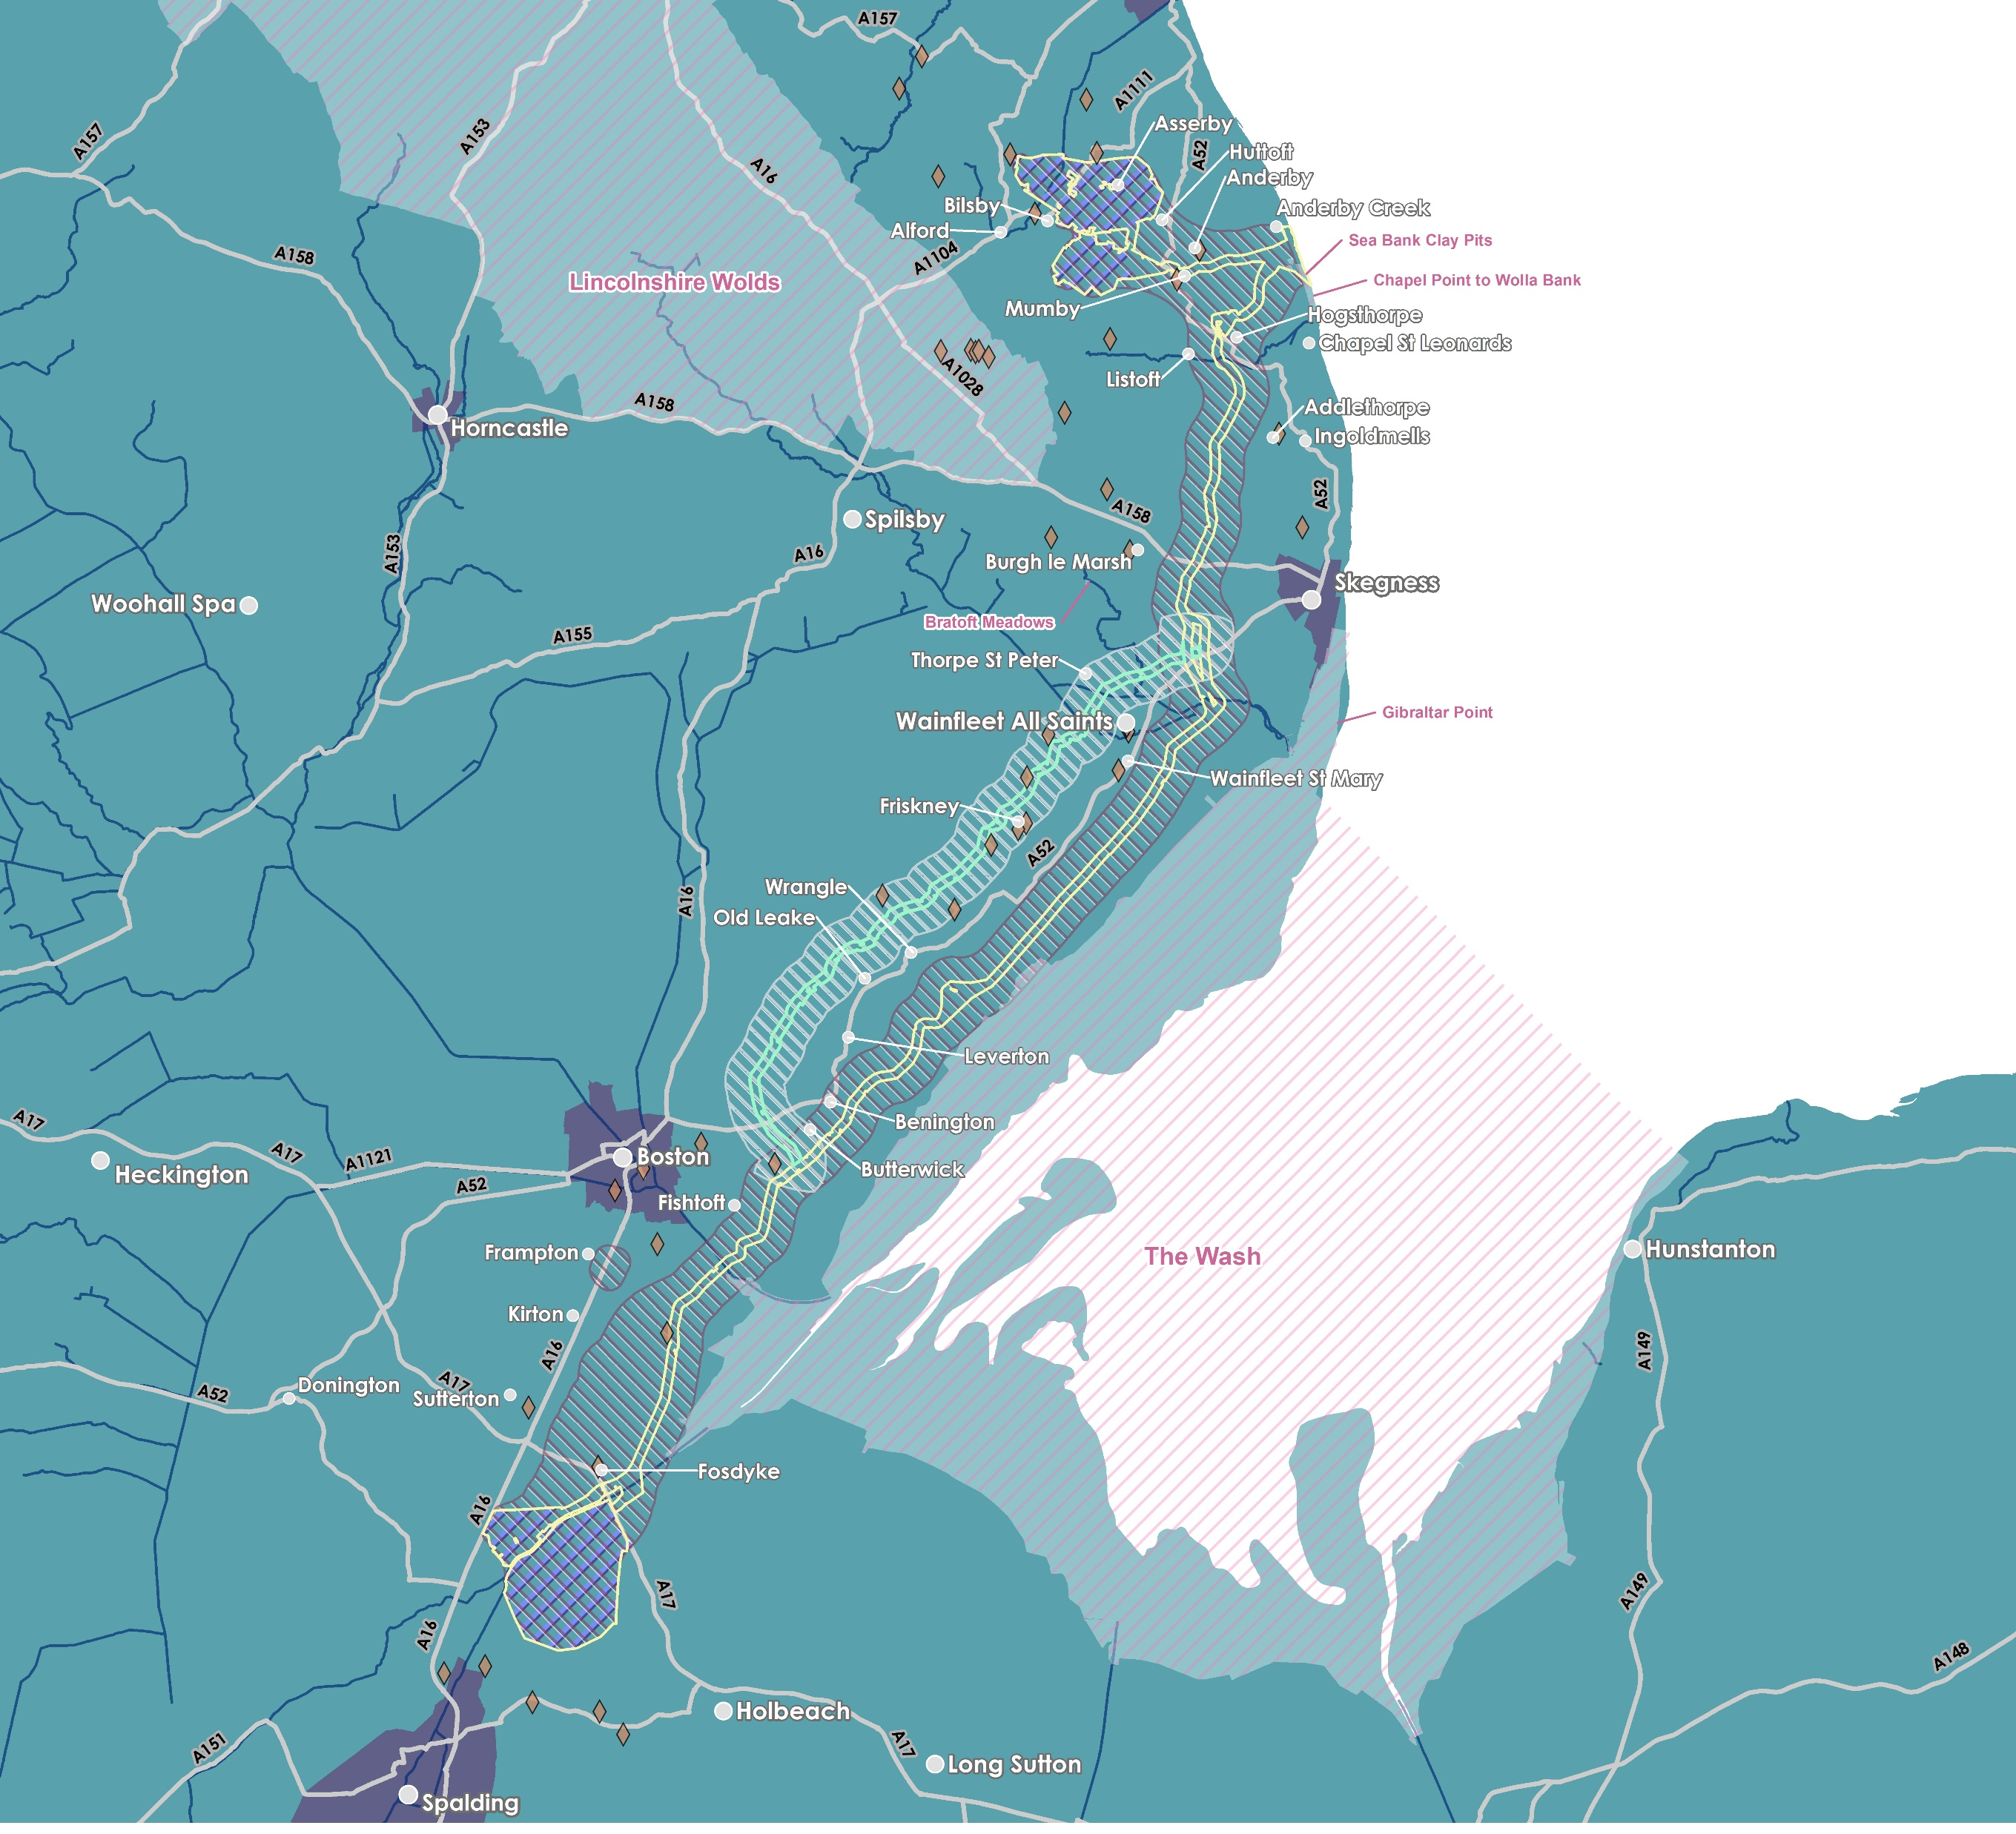
Lincolnshire Node
Our
Onshore
Proposals
Lincs Node Connection Option
Alternative Route Option to Weston Marsh (north of the A52)
Landfall south of Anderby Creek (there is only one landfall search zone as this has been assessed as the optimum search zone for both connection options);
Underground cables would continue underground to one of two different connection points still under consideration by National Grid;
a connection to the existing overhead line circuits at Weston Marsh (north of Spalding) or;
to a proposed new National Grid connection point, Lincolnshire Node, (east of Alford).
Original Route to Weston Marsh (south of the A52)
Alternative Route Option Search Zone
Alternative Route Option Indicative Cable Corridor
Original Onshore Cable Corridor
Original Onshore Search Zone
Scheduled Monument
Designated Site
Substation Search Zone
Weston Marsh Connection Option
Weston Marsh
Notes:
From the landfall, the cables would continue underground to one of two different connection points which were presented as recommendations under consideration by NG in their report which was published in July earlier this year– a connection to the existing overhead line circuits at Weston Marsh (north of Spalding) or to a proposed new National Grid substation (east of Alford). It’s important to note that one of these connection options will fall away in early new year. ​​
The OTNR Report published in July earlier this year laid out clearly that the option for Outer Dowsing to connect at Lincolnshire Node would be dependent on construction and commissioning of new 400kV overhead lines by National Grid and a new National Grid substation. The development, consenting and construction for any new overhead lines to enable the connection at Lincolnshire Node would be wholly the responsibility for National Grid – plans for this overhead line reinforcement scheme has been around for a number of years before Outer Dowsing was conceived. As a Nationally Significant Infrastructure Project in its own right, any network reinforcement proposals that NGET bring forward would require separate DCO consent and National Grid would be responsible for public consultation and EIA scoping for those.​
The option to connect at Weston Marsh would connect to existing 400kV overhead lines running north of Spalding and could potentially enable an earlier connection date compared to Lincolnshire Node.​
As part of the feedback received during the Phase 1 consultation on our original route, we were made aware of various engineering and environmental considerations potentially affecting the original proposed cable corridor to the Weston Marsh connection option. As a result of this feedback, the Project is considering a proposed amendment to the central section of the onshore cable route option to Weston Marsh (“Alternative Route Option”) as shown on this plan in a brighter green, to the north of the A52. These considerations were Geology (potential for “Running Sands”) Hydrology (high water table) and Agricultural & Farming Practices. Both options are on the table, both routes will be fully assessed in our Preliminary Environmental Information Report (PEIR) and our Phase 2 Consultation will encompass both route options. ​
Once fully assessed the project will make a route selection based upon the full information available and will continue with a single proposed route option. connection option. ​
The Cable corridor is a refined area of search approximately 300m wide for the placement of the onshore underground cables. Whilst the width of the cable corridor may fluctuate along the route to account for specific environmental or engineering constraints, the project will require a typical working corridor of 80m during construction, reducing to a typical 60m wide corridor post construction. The original cable search zone and corridor presented in Phase 1 Consultation Events remain under consideration alongside this alternative route option.​
​
​
​
​
​

Slide 7
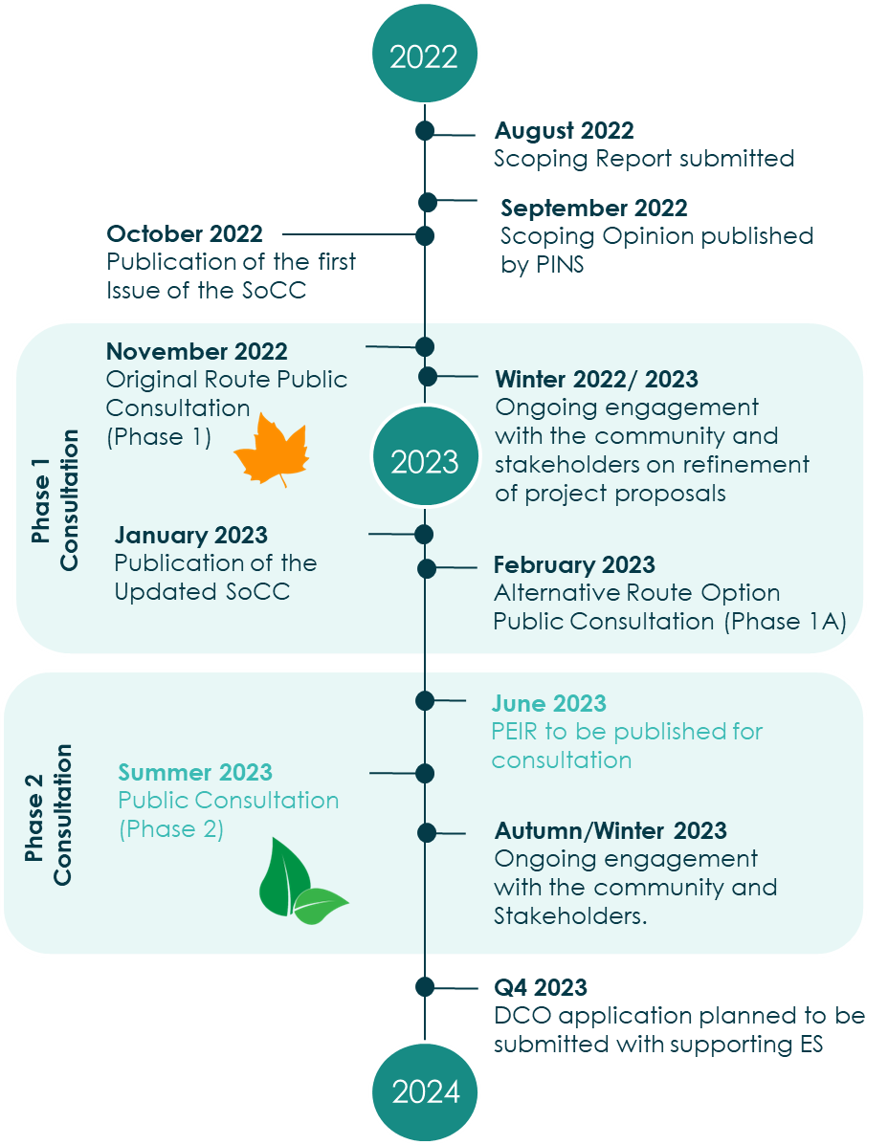
Programme
We are here

Slide 8


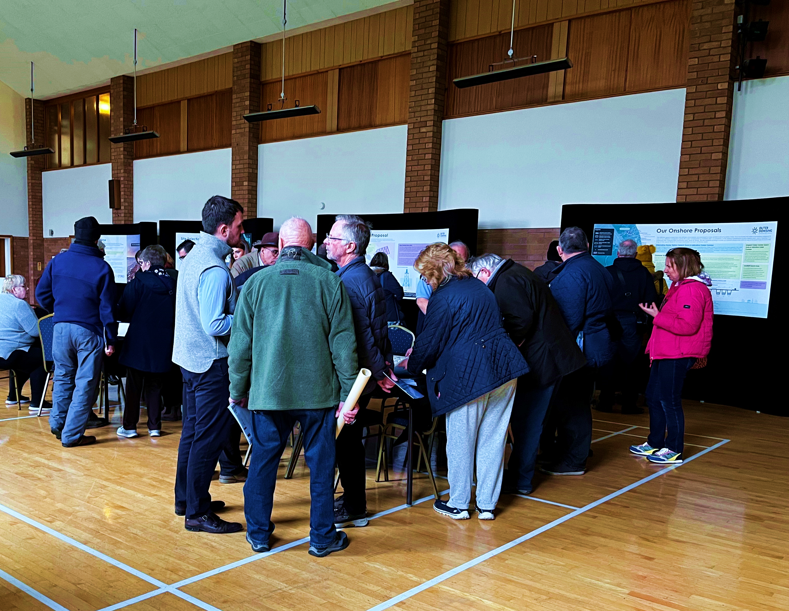
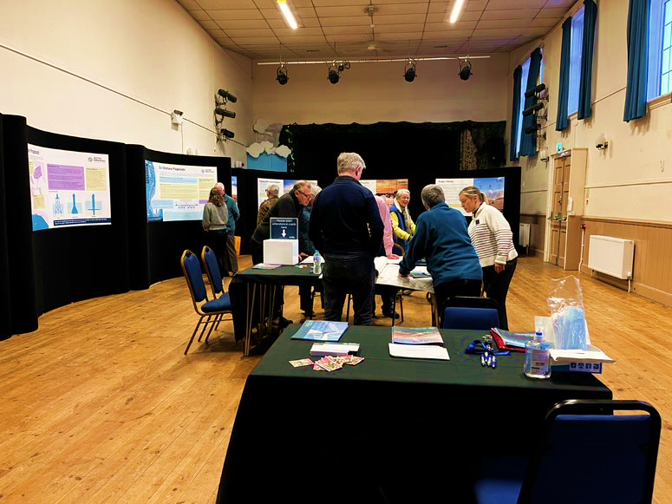
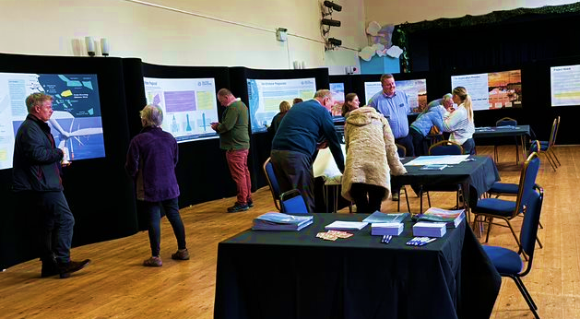
Public Consultation Events to date
November 2022
Original Route Public Consultation (Phase 1)
February 2023
Alternative Route Option Public Consultation (Phase 1A)
4x Public Information Days
c. 500 attendees
2 Webinars, Online virtual exhibition, Questionnaires / feedback forms, Freephone, Email, social media
4x Community Liaison Groups established with all affected Parish Councils & Landowner Interest Group established
Winter Newsletter – summarising feedback and introducing Phase 1A Consultation
2x Public Information Days
c. 300 attendees
2 Webinars, Online virtual exhibition, Questionnaires / feedback forms, Freephone, Email, social media
4x Community Liaison Groups met with additional affected Parish Councils & Landowner Interest Group met
Spring Newsletter– summarising feedback and next steps

Slide 9
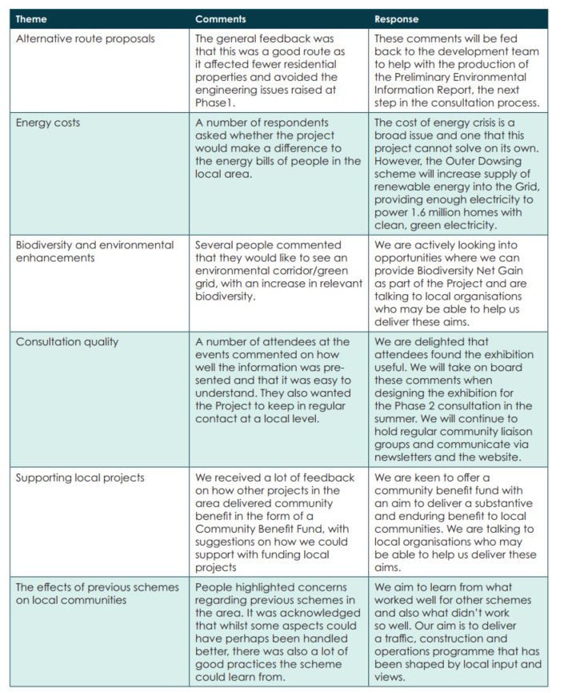

Newsletter – Spring 2023

Slide 10
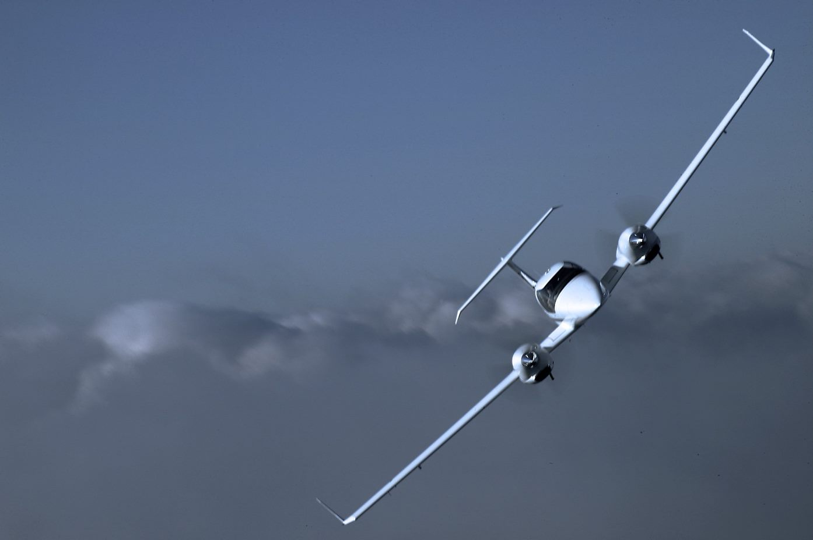
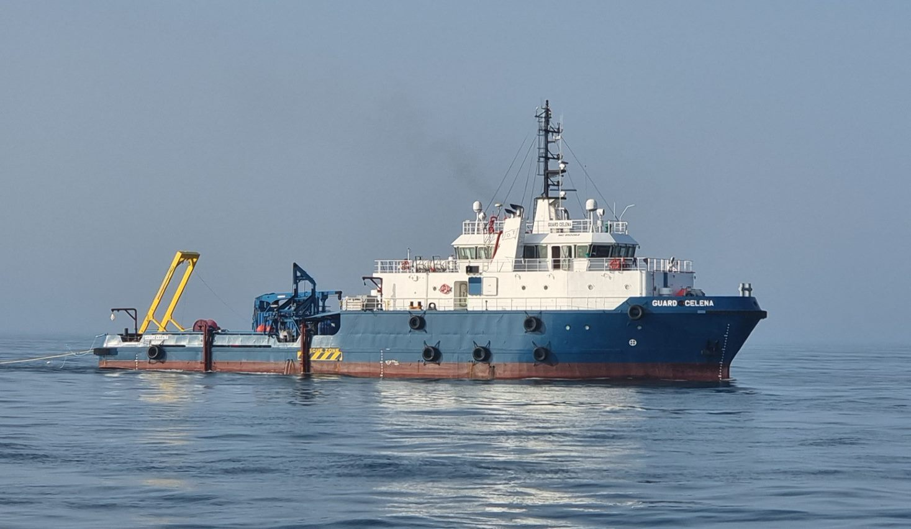
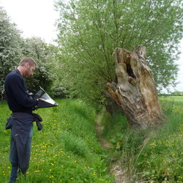
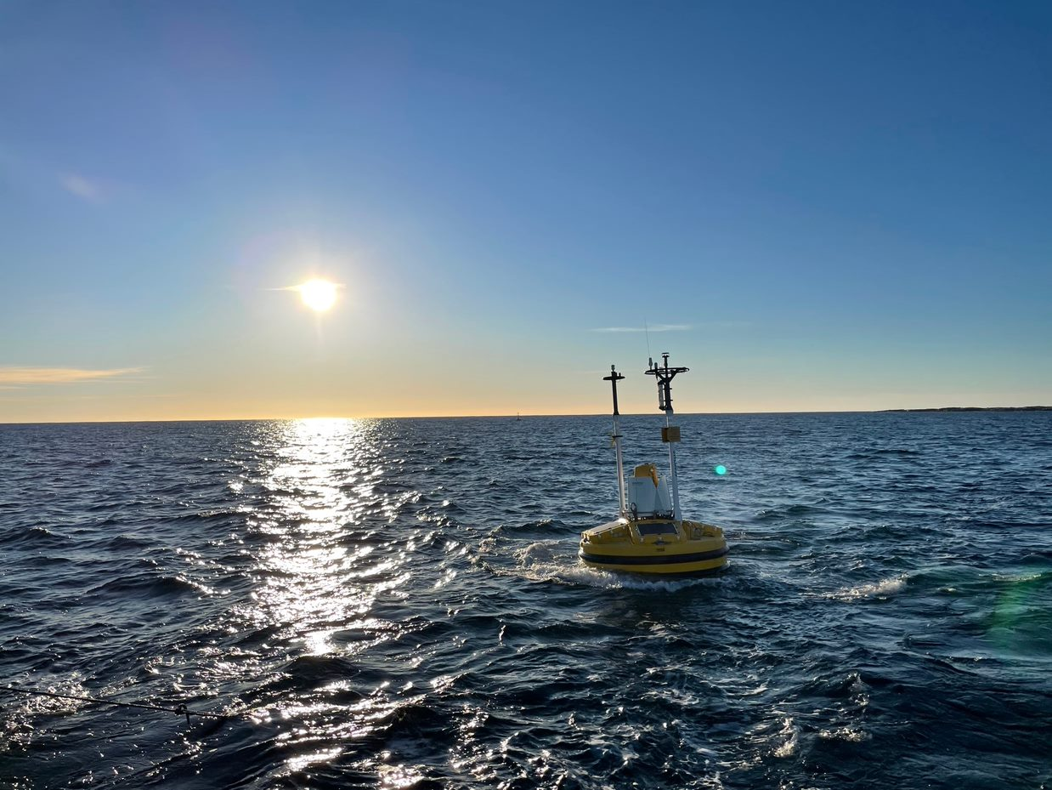
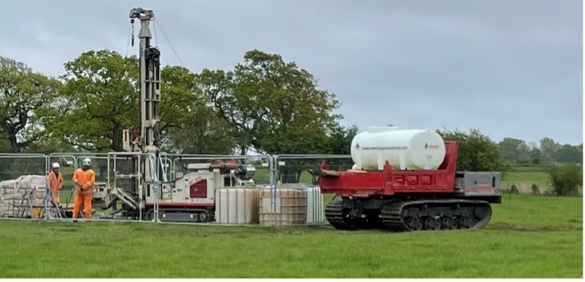

Gathering environmental data
Onshore Surveys
Ornithology – wintering bird surveys
Ecology – Phase 1 Habitat surveys & protected species surveys
Archaeology – geophysical and trial trenching investigations
Engineering – geotechnical, topographical, soil thermal resistivity
Traffic & Transport – traffic counts
Visual – photomontages of substation
Geology & hydrology – flow rates, filtration, drainage
Aerial Photography – Hi-res aerial imagery, vegetation survey and Lidar
Meteorology – weather & climate
Offshore Surveys
Geophysical & Geotechnical
Metocean & wind resource
Ornithology & Marine Mammals
Benthic ecology
Marine Traffic Surveys
Notes:
Having a comprehensive and accurate baseline of environmental and engineering data is critical to the success of our project. We want to ensure that we optimise our design to the site conditions and that we minimise the impact on a wide range of biological, physical and human environmental receptors through sensitive design, mitigation and monitoring. A lot of these surveys go unnoticed, but we invest significant resources through industry leading contractors to acquire data across a wide range of disciplines.
For example, we have just last month completed 2 years of offshore aerial surveys of birds & marine mammals, and also completed last week a high resolution onshore aerial survey of all cable route and substation options. We are looking to undertake a short geotechnical survey campaign from the end of March to ground truth the geology at key locations where we will need to bury our cable deeper under features such as major river channels and at the landfall at Wolla Bank.

Slide 11
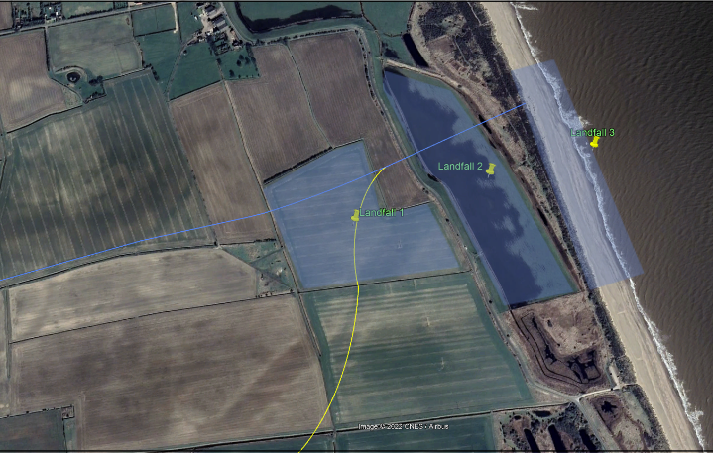
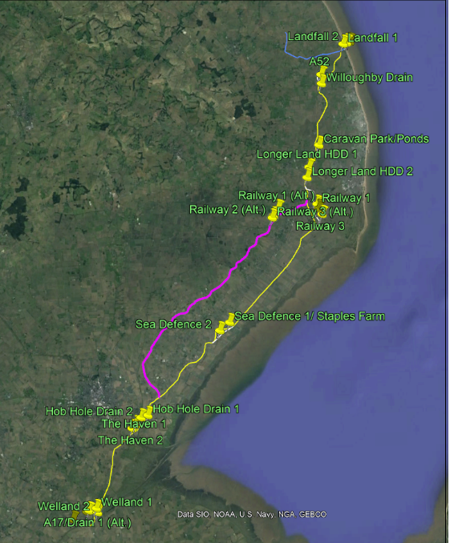
Onshore Geotechnical Survey
Scope
Up to 25 Geotechnical boreholes (15-30m deep)
Trial Pits (3m x 2m)
Cone Penetration Tests (CPTs)
Programme
Mid-May- ~6 weeks
Stakeholder Engagement
Natural England
Lincolnshire Wildlife Trust
The Crown Estate
ELDC, LCC & Parish Councils
Site Notices for beach at Wolla Bank
Access arrangements
Intrusive Survey Licenses from landowners

Slide 12
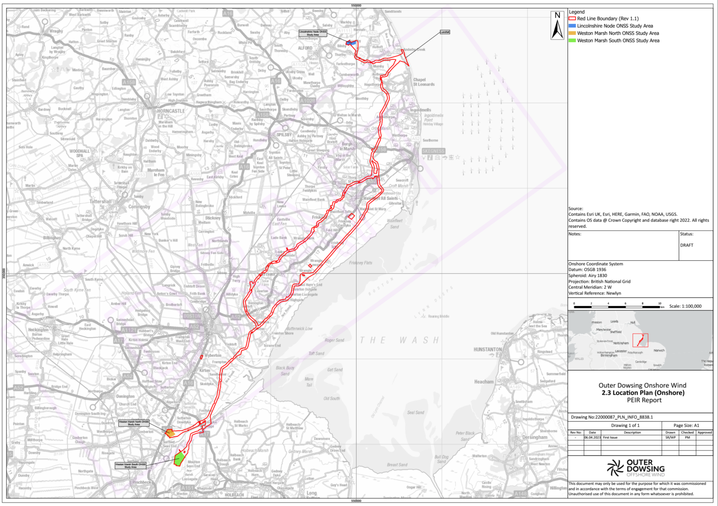
Onshore Cable Route – Access & Temporary Compounds

Slide 13
CLG – Substation North

Slide 14

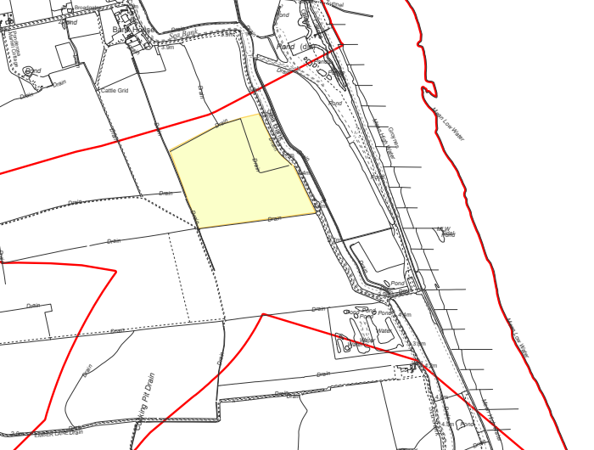
Onshore Cable Route – Access & Temporary Compounds
Landfall
PEIR Boundary
Compound
Roman Bank, Anderby, Chapel St Leonards, East Lindsey, Lincolnshire, PE24 5XH

Slide 15
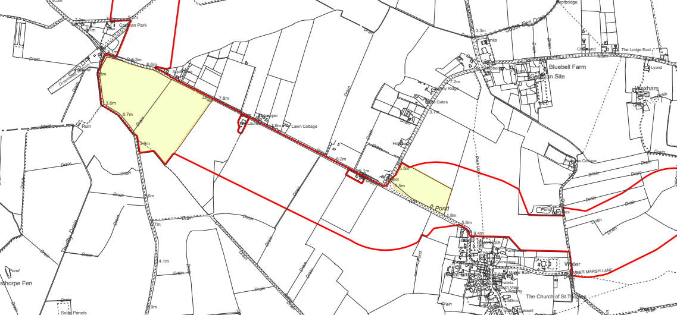
Onshore Cable Route – Access & Temporary Compounds
Lincs Node Cable Route
PEIR Boundary
Compound
Station Road, Hill Foot, Mumby, East Lindsey, Lincolnshire, LN13 9JT
Mumby

Slide 16
CLG – Cable Route North

Slide 17
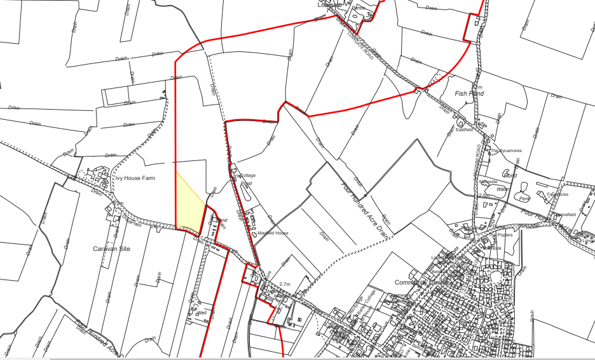
Onshore Cable Route – Access & Temporary Compounds
Weston Marsh North Cable Route
PEIR Boundary
Compound
Bracken Lane, South End, Ingle Nook, Hogsthorpe, Mumby, East Lindsey, Lincolnshire, LN13 9SG
Hogsthorpe

Slide 18
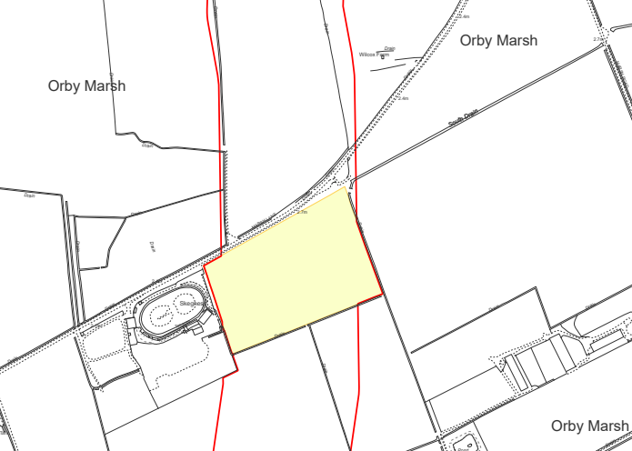
Onshore Cable Route – Access & Temporary Compounds
Weston Marsh Northern Cable Route
PEIR Boundary
Compound
Skegness Stadium, Marsh Lane, The
Holding, Orby, East Lindsey, Lincolnshire,
PE24 5JA

Slide 19
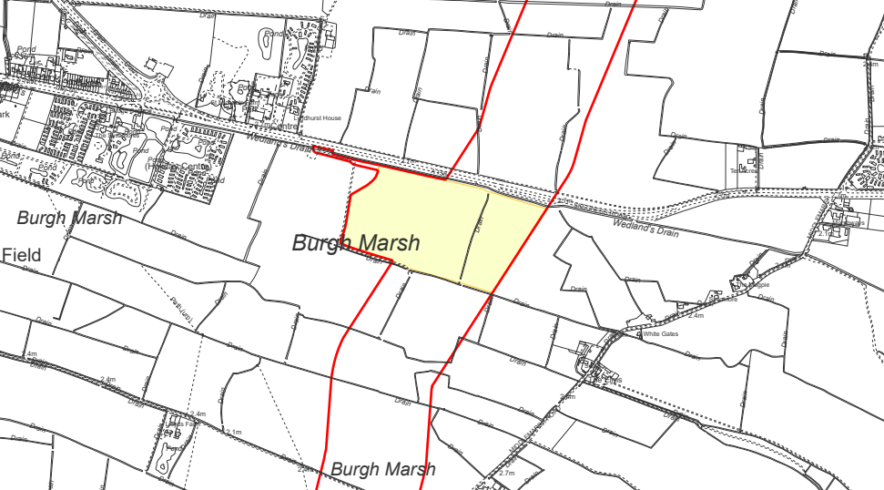
Onshore Cable Route – Access & Temporary Compounds
Weston Marsh Northern Cable Route
PEIR Boundary
Compound
Skegness Road, St Michaels Farm, Burgh le
Marsh, East Lindsey,
Lincolnshire, PE24 5AB

Slide 20
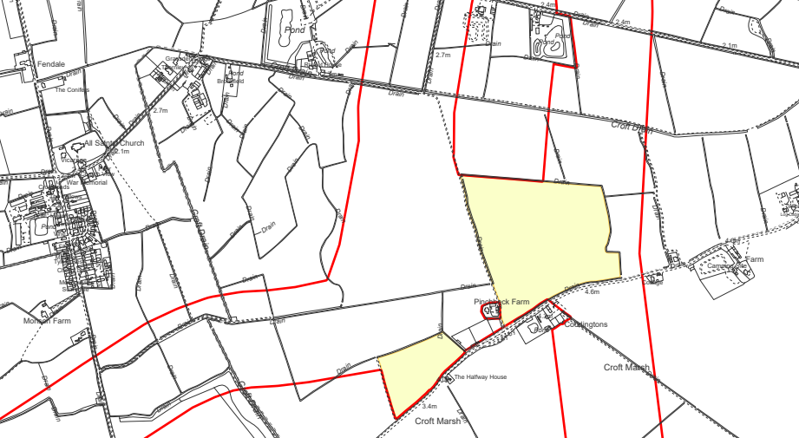
Onshore Cable Route – Access & Temporary Compounds
Weston Marsh Northern Cable Route
PEIR Boundary
Compound
Pinchbeck Lane, Rivulet House, Croft, East
Lindsey, Lincolnshire, PE24 4RY
Croft

Slide 21
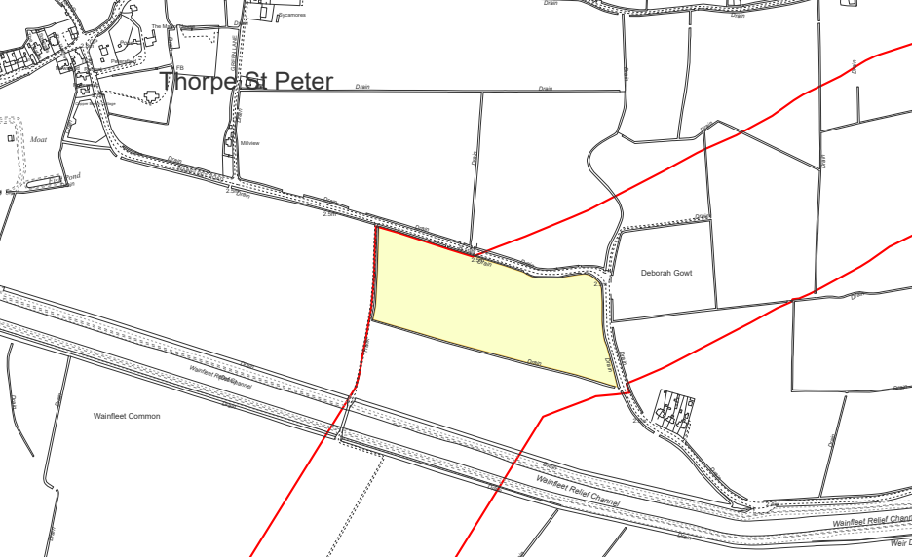
Onshore Cable Route – Access & Temporary Compounds
Weston Marsh Northern Cable Route
PEIR Boundary
Compound
Wainfleet Road, Ivy Cottage, Thorpe St.
Peter, East Lindsey, Lincolnshire, PE24 4NS

Slide 22
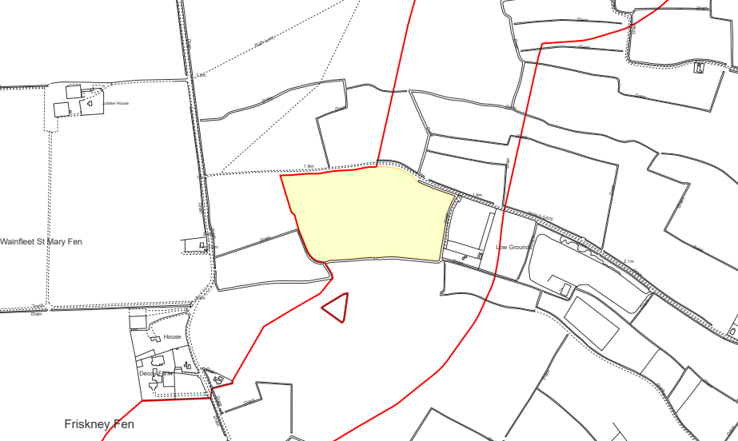
Onshore Cable Route – Access & Temporary Compounds
Weston Marsh Northern Cable Route
PEIR Boundary
Compound
Hallgate Road, Church Cottages, Wainfleet
St Mary, East Lindsey, Lincolnshire, PE24 4JT

Slide 23
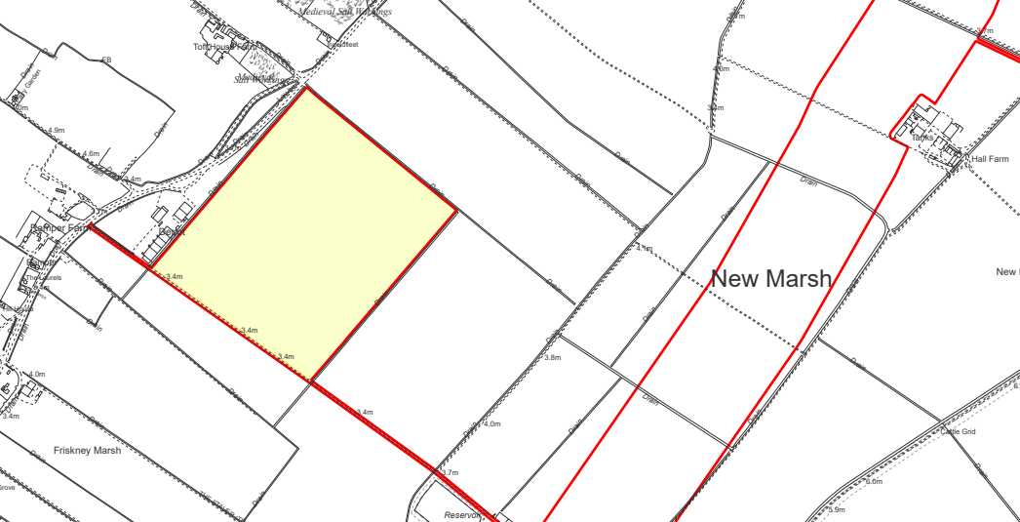
Onshore Cable Route – Access & Temporary Compounds
Weston Marsh Northern Cable Route
PEIR Boundary
Compound
Low road
Brays Farm, Boston Road, Toft House Farm, Wainfleet St Mary, East Lindsey, Lincolnshire, PE24 4HJ

Slide 24
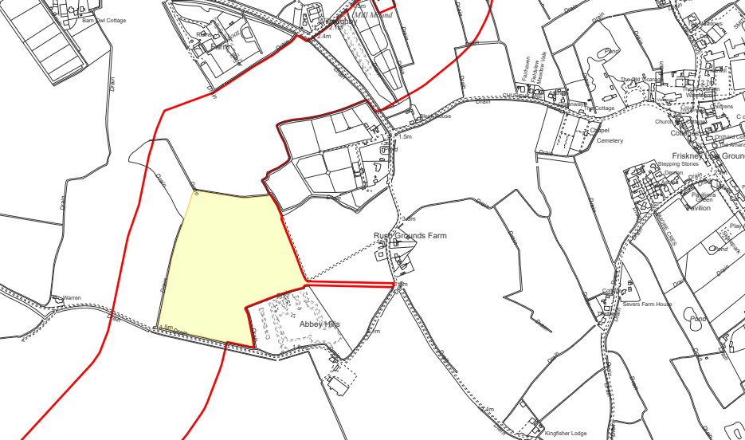
Onshore Cable Route – Access & Temporary Compounds
Weston Marsh Northern Cable Route
PEIR Boundary
Compound
Friskney
Small End, The Rookery, Friskney, East Lindsey, Lincolnshire, PE22 8PQ

Slide 25
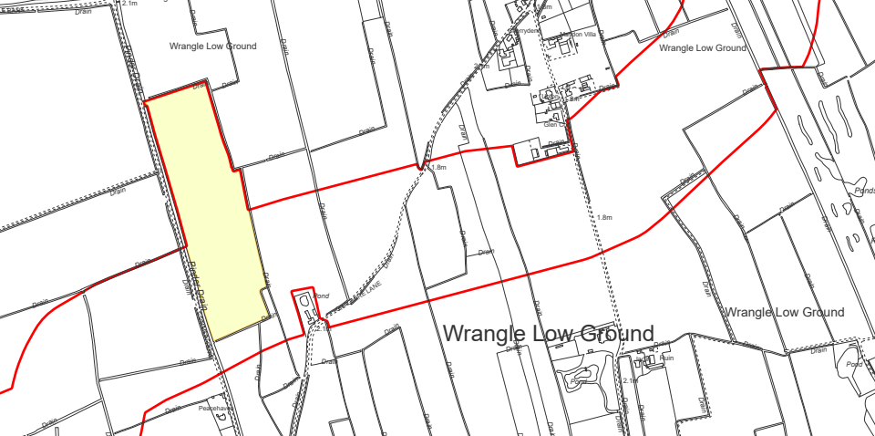
Onshore Cable Route – Access & Temporary Compounds
Weston Marsh Northern Cable Route
PEIR Boundary
Compound
Cragmire Lane, Maydon Villa, Wrangle CP, Wrangle, Boston, Lincolnshire, PE22 9DZ

Slide 26
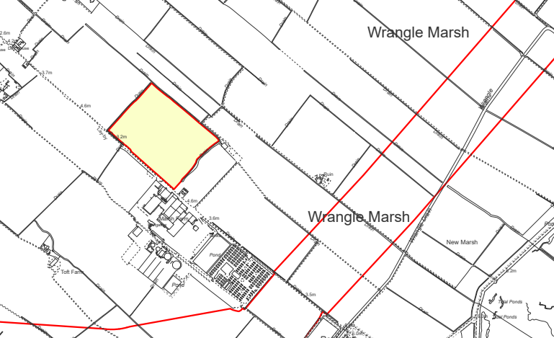
Onshore Cable Route – Access & Temporary Compounds
Weston Marsh Northern Cable Route
PEIR Boundary
Compound
Sea Lane, Marsh Farm, Wrangle CP, Wrangle, Boston, Lincolnshire, PE22 9HE

Slide 27
CLG – Cable Route South

Slide 28
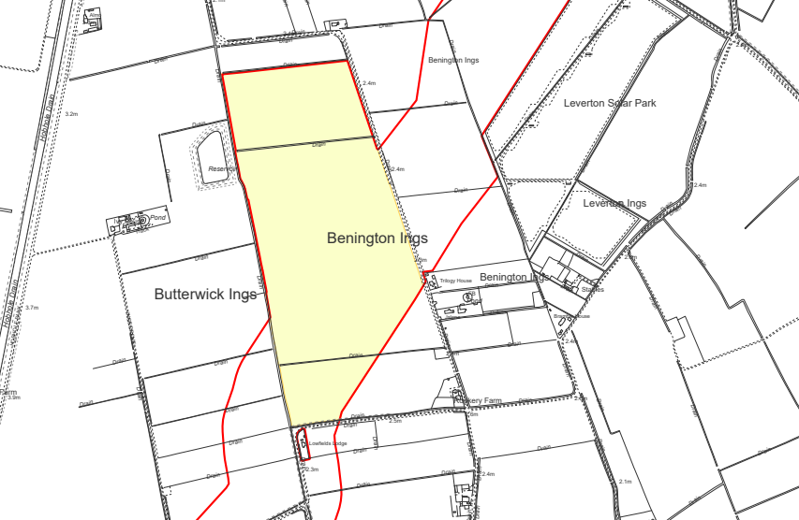
Onshore Cable Route – Access & Temporary Compounds
Weston Marsh Southern Cable Route
PEIR Boundary
Compound
Ings Road, Southway, Benington CP, Boston, Lincolnshire, PE22 0PZ

Slide 29
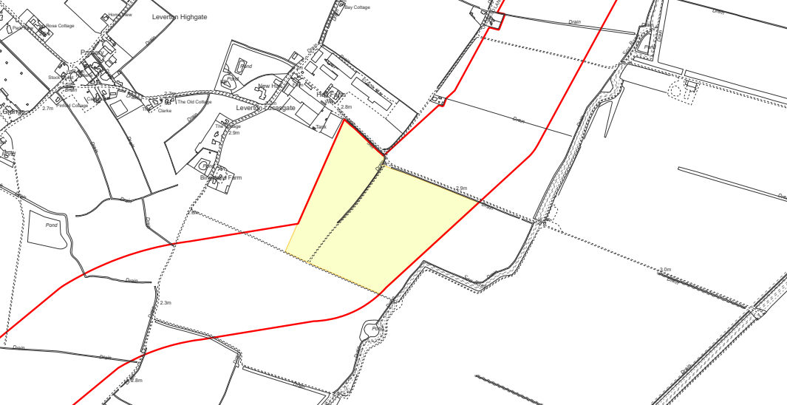
Onshore Cable Route – Access & Temporary Compounds
Weston Marsh Southern Cable Route
PEIR Boundary
Compound
Sea Lane, Glebe Farm, Benington CP,
Boston, Lincolnshire, PE22 0DH

Slide 30
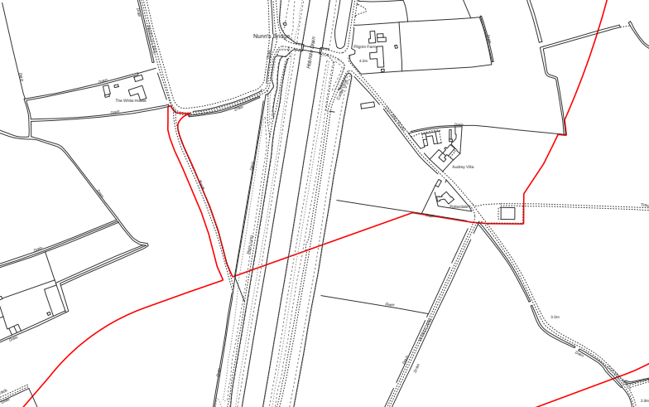
Onshore Cable Route – Access & Temporary Compounds
Weston Marsh Southern Cable Route
PEIR Boundary
Compound
Hobhole Bank, Pinfold Lane, Laurel Farm, Fishtoft CP, Fishtoft, Boston, Lincolnshire, PE21 0SL

Slide 31
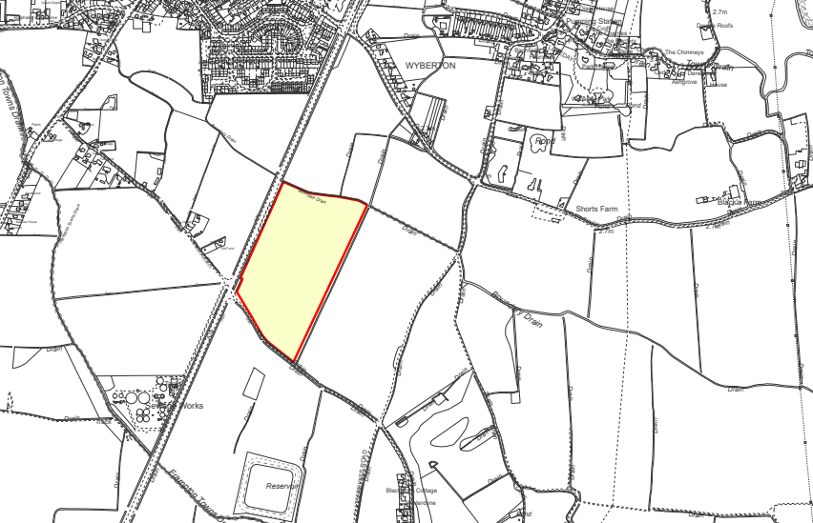
Onshore Cable Route – Access & Temporary Compounds
Weston Marsh Southern Cable Route
PEIR Boundary
Compound
A16, Old Farm, Frampton CP, Wyberton,
Boston, Lincolnshire, PE20 1EB

Slide 32
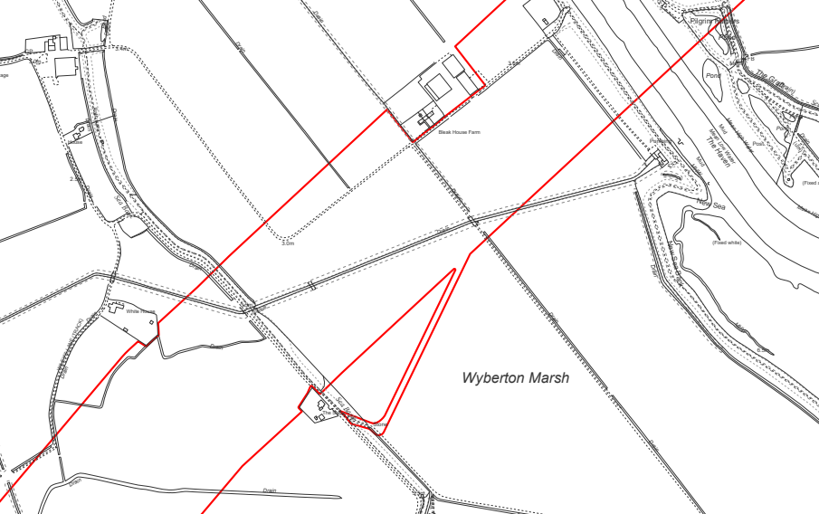
Onshore Cable Route – Access & Temporary Compounds
Weston Marsh Southern Cable Route
PEIR Boundary
Compound
Bleak House Farm, 3, Wyberton Roads, Bank House, Wyberton CP, Boston, Lincolnshire, PE20 1BD

Slide 33
CLG – Substation South

Slide 34
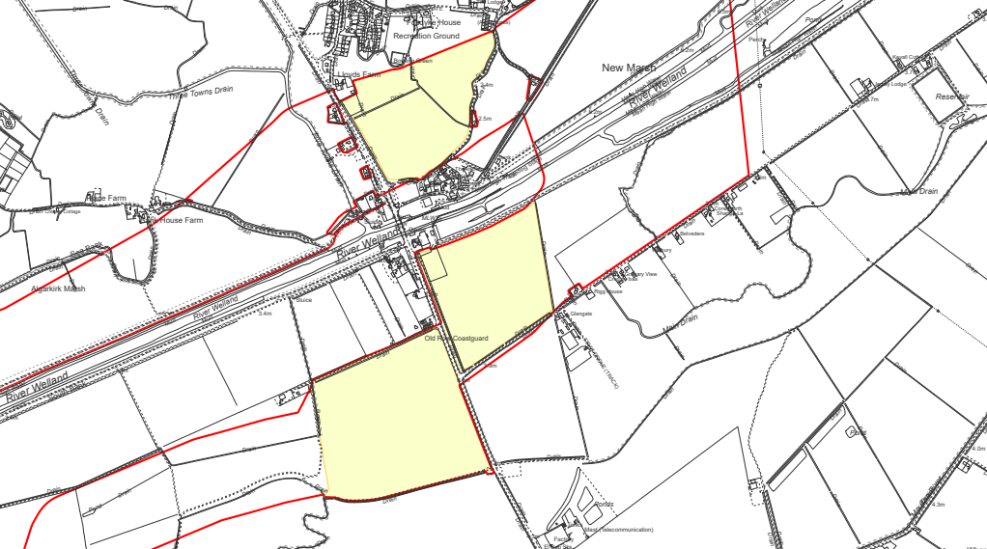
Onshore Cable Route – Access & Temporary Compounds
Weston Marsh Substation South
PEIR Boundary
Compound
Fosdyke Bridge, Bram Lea, Fosdyke CP,
Fosdyke, Boston, Lincolnshire, PE12 6LH

Slide 35
Lincs Node Substation Search Zone
Our Onshore Substation Study Areas
Until a final grid connection is confirmed, we have two study areas for the onshore substation & associated infrastructure required to connect to the National Grid transmission system.
Weston Marsh connection option
Here there would be the Outer Dowsing substation & a National Grid Customer Substation. Some overhead line modifications will be required at, or near to, the ODOW/National Grid substation(s) to facilitate the connection of our project at this location.
  Lincolnshire Node connection option
  Here there would be the Outer Dowsing substation & we would be connected to the planned National Grid wider reinforcement works, this is likely to require a larger footprint, however the details of these plans are not yet known.
Weston Marsh Substation(s) Search Zone
Notes:
Until we have secured a final grid connection, we currently have two search zones for the onshore substation & associated infrastructure required to connect to the National Grid transmission system. Only one of these zones, along with the associated onshore cable route will be progressed once a final connection point is confirmed.​
​
For the Weston Marsh connection option (in the south), the overall footprint of substation works for Outer Dowsing and the National Grid enabling works required to connect to the existing National Grid transmission system is anticipated to have a maximum footprint of 9.2 hectares for the operational substation footprint and 18 hectares for the total land take to include mitigation and drainage. Some overhead line modifications will be required at, or near to, the ODOW/National Grid substation(s) to facilitate the connection of our project at this location.​
​
For the Lincolnshire Node connection option (in the north), the combination of the Outer Dowsing substation and the planned National Grid wider reinforcement works is likely to require a larger footprint, however the details of these plans are not yet known.​
​
Further detail on works required to connect the project to the National Grid transmission system are anticipated to be available upon conclusion of the OTNR process, including information on what aspects of the required National Grid works would be included in the Outer Dowsing DCO application.

Slide 36
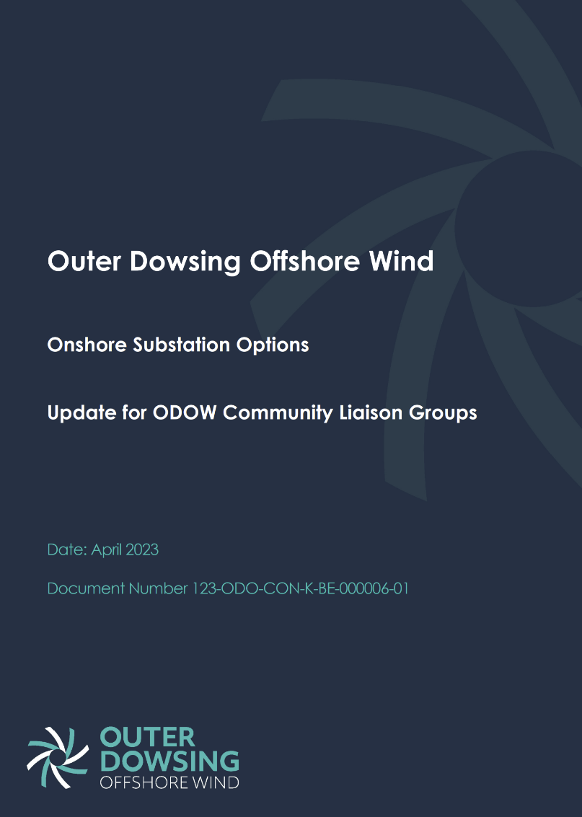
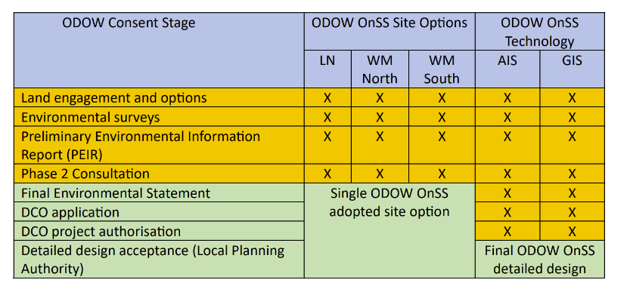
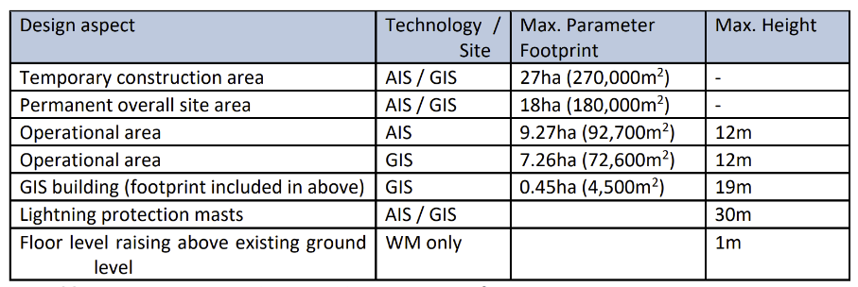
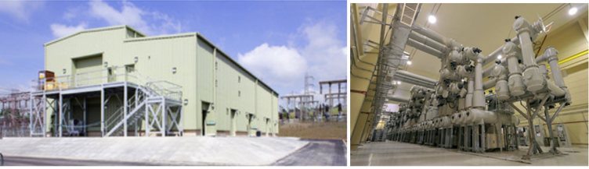
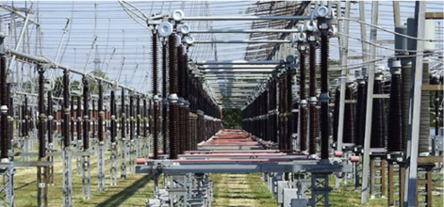
Substation Options – Design Parameters
Memo issued to CLG members on 13th April
Both Air Insulated Substation (AIS) and Gas Insulate Substation (GIS) being considered
A set of maximum parameters have been defined, to create an ‘envelope’ for assessment that will accommodate any of the options under consideration.
The detailed design of the ODOW OnSS will be undertaken post-consent with the envelope defined in the DCO and assessed in the ES.

Slide 37
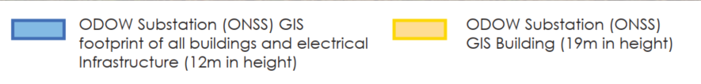
Onshore Substation Visualisations
For the purpose of presenting a Realistic Worst Case (RWC) Scenario, all the visualisations at this stage assume a GIS footprint. It should be noted, while the adopted layouts may represent a worst case in respect of specific topics or receptors, in others it may not. The individual topic chapters in the PEIR will each outline how the ONSS has been assessed to reflect a RWC for each technical assessment.
30m
Lightning Protection Mast
ODOW GIS Building footprint
(4,500m²)
19m
[All other electrical infrastructure within footprint. Not including landscaping or drainage.]
ODOW GIS footprint (72,600m²)
12m
^{1x ONSS}

Slide 38
National Grid Onshore Substation
In addition to the ODOW OnSS, a National Grid Onshore Substation (NG OnSS) and associated enabling works will be required at, or near to, the ODOW OnSS.
For a connection at the proposed Lincolnshire Node location, NGET proposes to build a new overhead line and new NGET substation to accommodate multiple connections. Our current understanding is that the NG OnSS would be located within the onshore substation search zone presented at our Phase 1 and 1A Consultation events and would be connected to the ODOW OnSS by underground cables.
The Lincolnshire Node scheme was proposed by National Grid several years before ODOW approached National Grid for a connection and it is a strategic proposal relating to reinforcement of the wider transmission network rather than being instigated to serve any individual development.
For a connection at the proposed WM North and WM South locations into the existing NGET overhead line, new NGET infrastructure will be required to facilitate a connection for ODOW. Based on other similar connections this will likely consist of a new NGET substation and localised alterations to the overhead lines to form the connection.
The NG OnSS could utilise AIS or GIS technology and it is likely that the necessary infrastructure will be designed and constructed by NGET.

Slide 39
Substation Options – Site Selection Criteria
Developable plot criteria:
Close proximity to the National Grid area of search
Providing an area of land large enough to meet the requirements of the Project OnSS
As far as possible, free from environmentally sensitive receptors
Not within 200m of any occupied building.
Environmental constraints appraisal considering the following issues:
Air quality
Archaeology and cultural heritage
Ecology and ornithology
Geology and ground conditions
Hydrology and flood risk
Land use
Noise and vibration
Traffic and transport
Landscape and visual assessment
Planning

Slide 40
Substation Options – Lincs Node Long List

Slide 41
Substation Options – Lincs Node

Slide 42
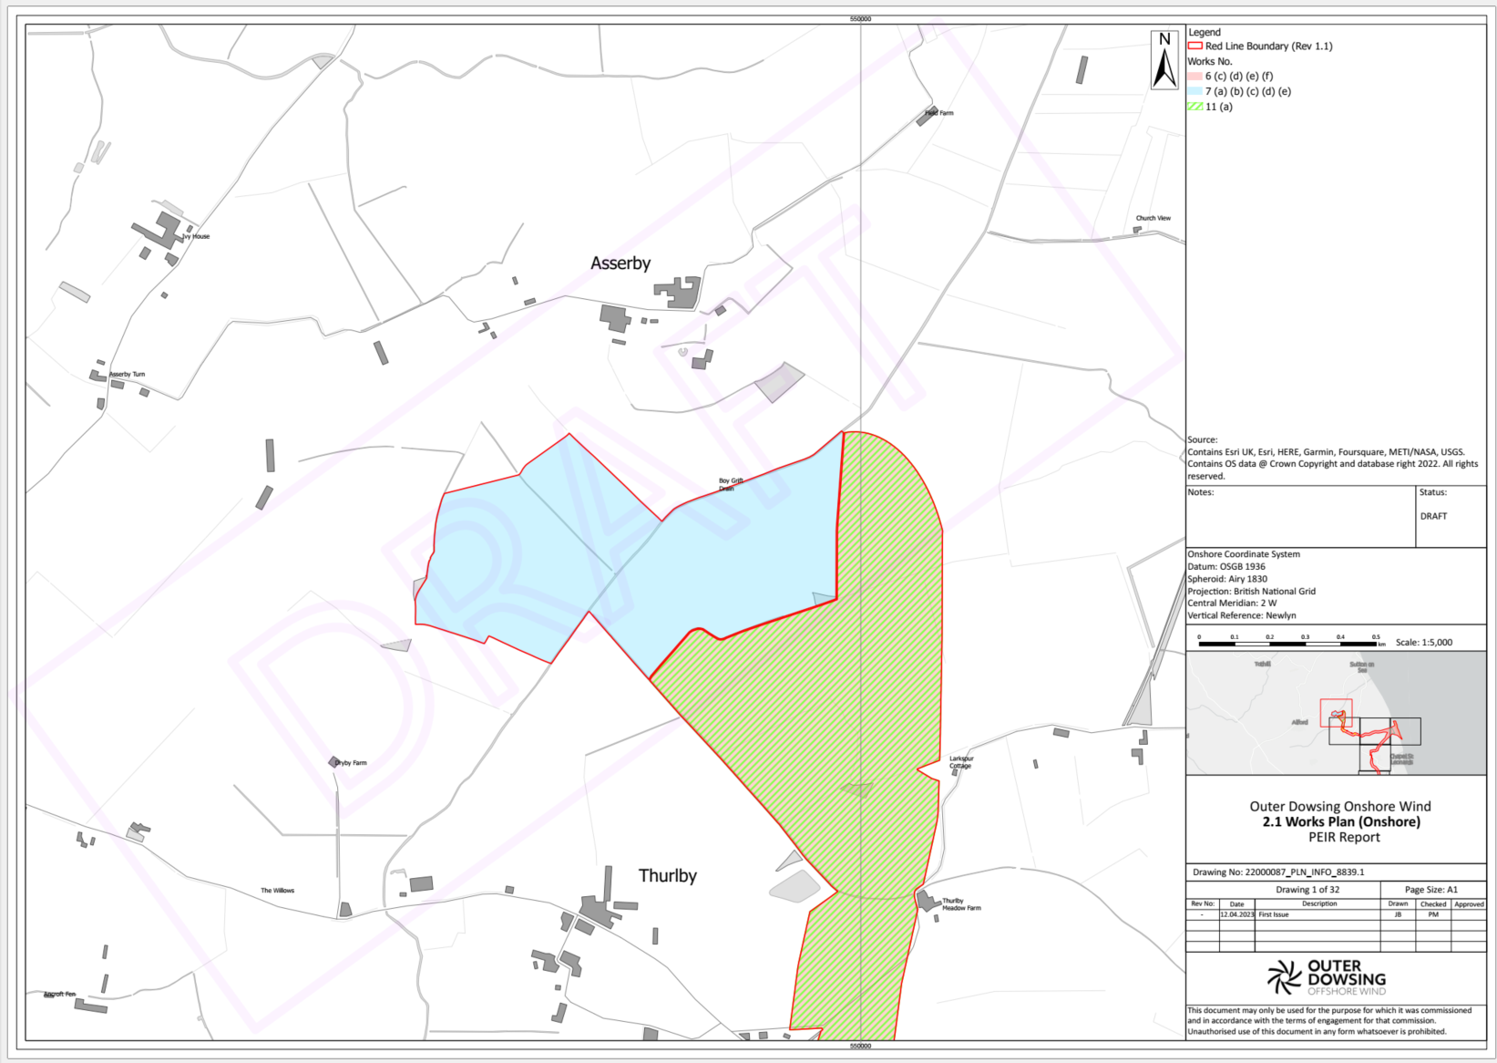
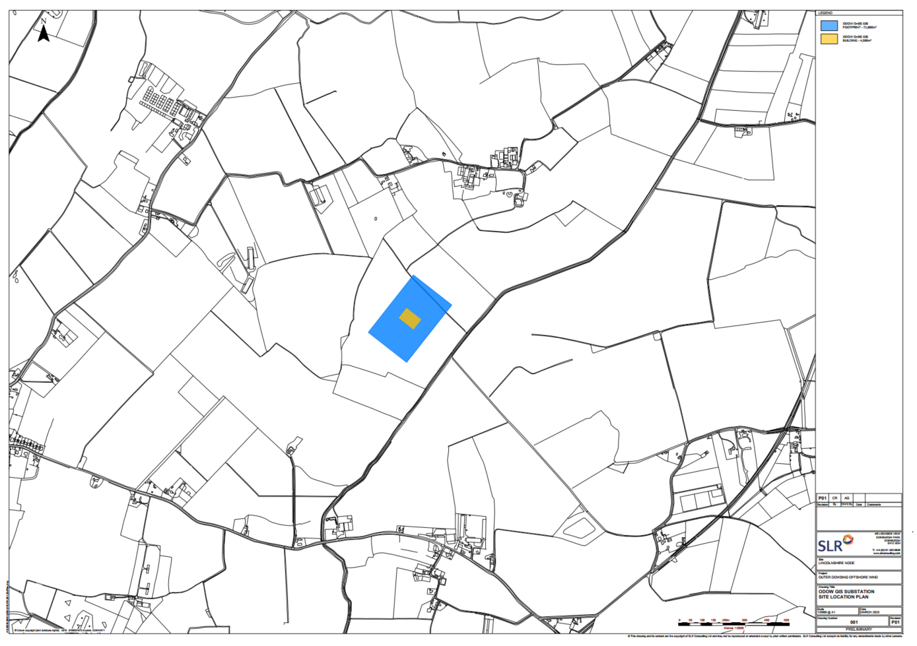
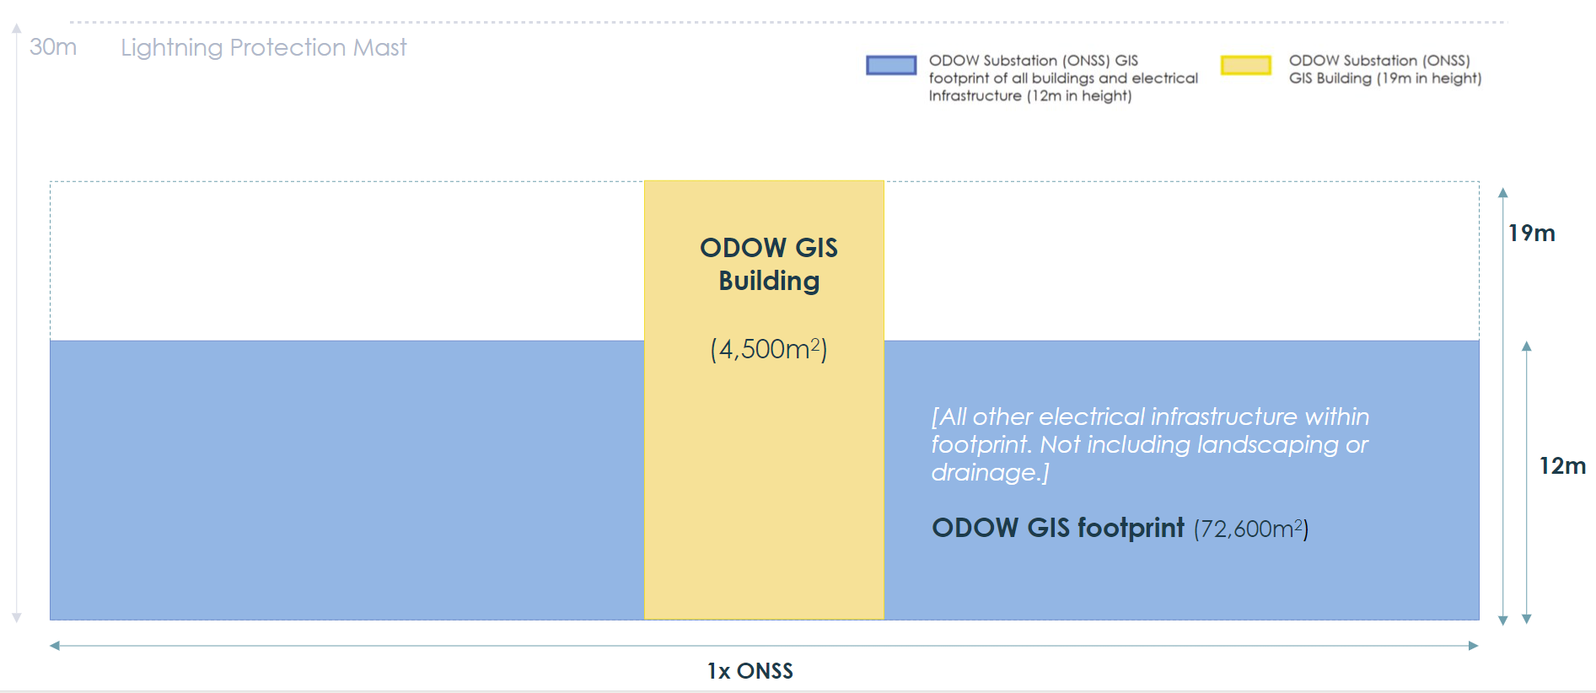
Substation Options – Lincs Node

Slide 43
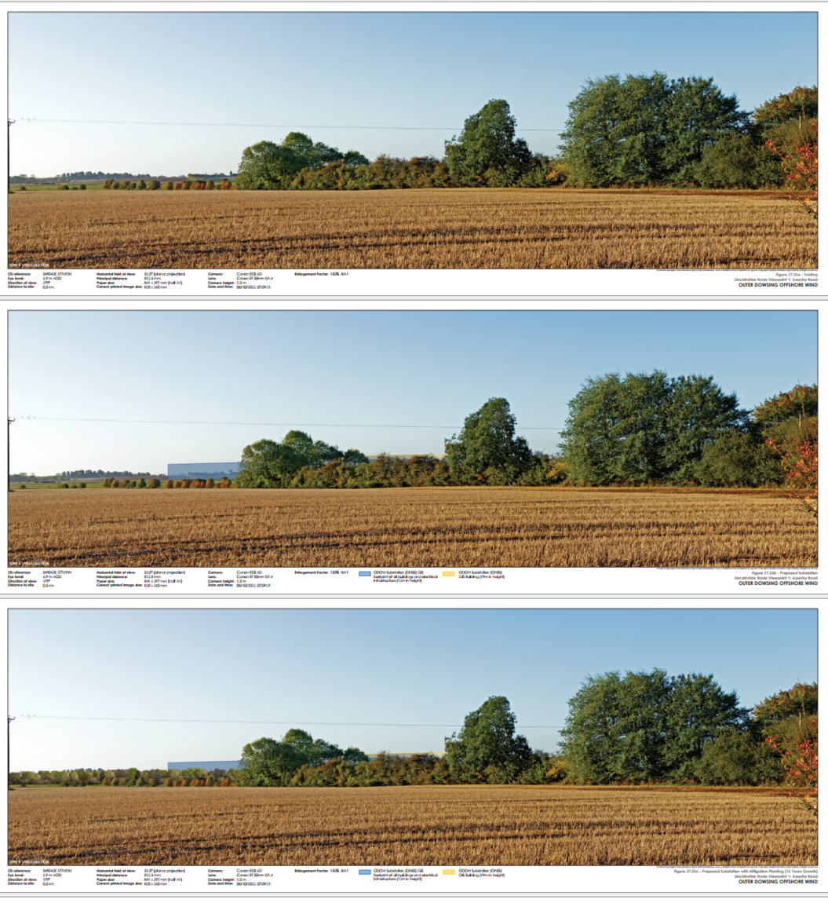
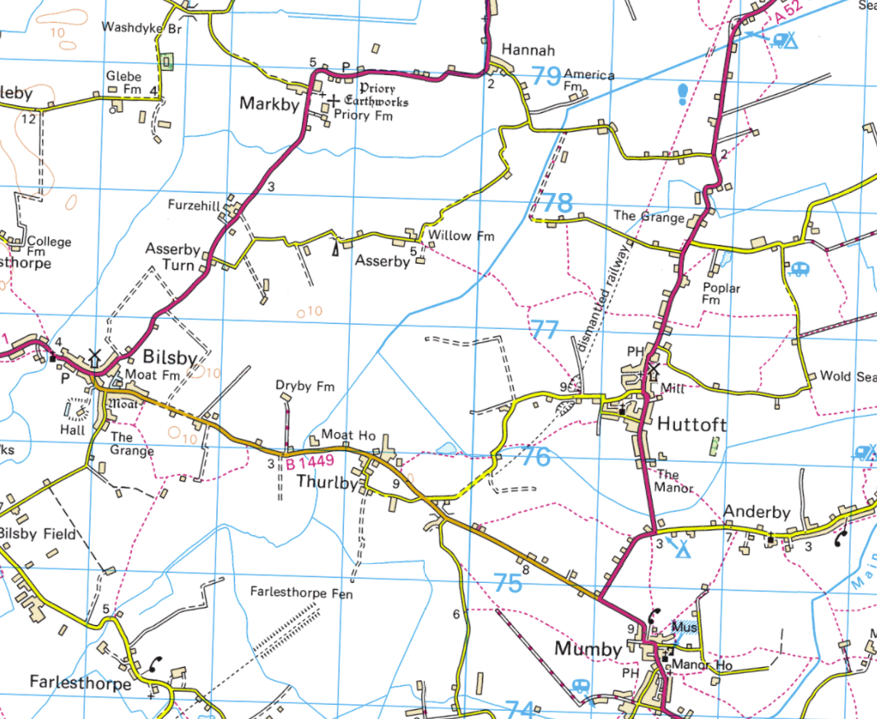
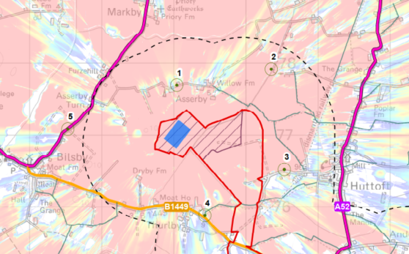
Substation Options – Lincs Node
Existing View
Lincolnshire Node Viewpoint 1: Asserby Road
1
2
5
Year 1
3
4
Year 15

Slide 44
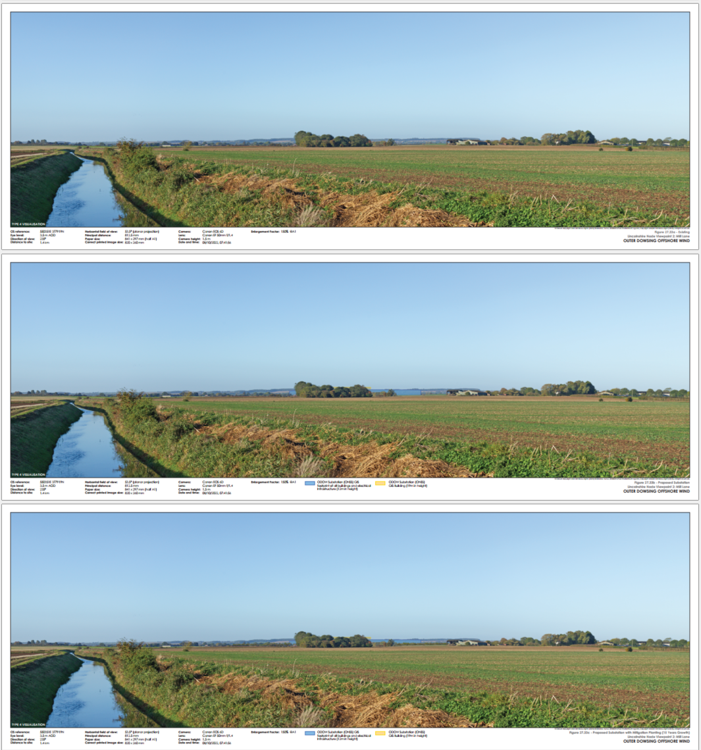
Substation Options – Lincs Node
Existing View
Lincolnshire Node Viewpoint 2: Mill Lane
1
2
5
3
Year 1
4
Year 15

Slide 45
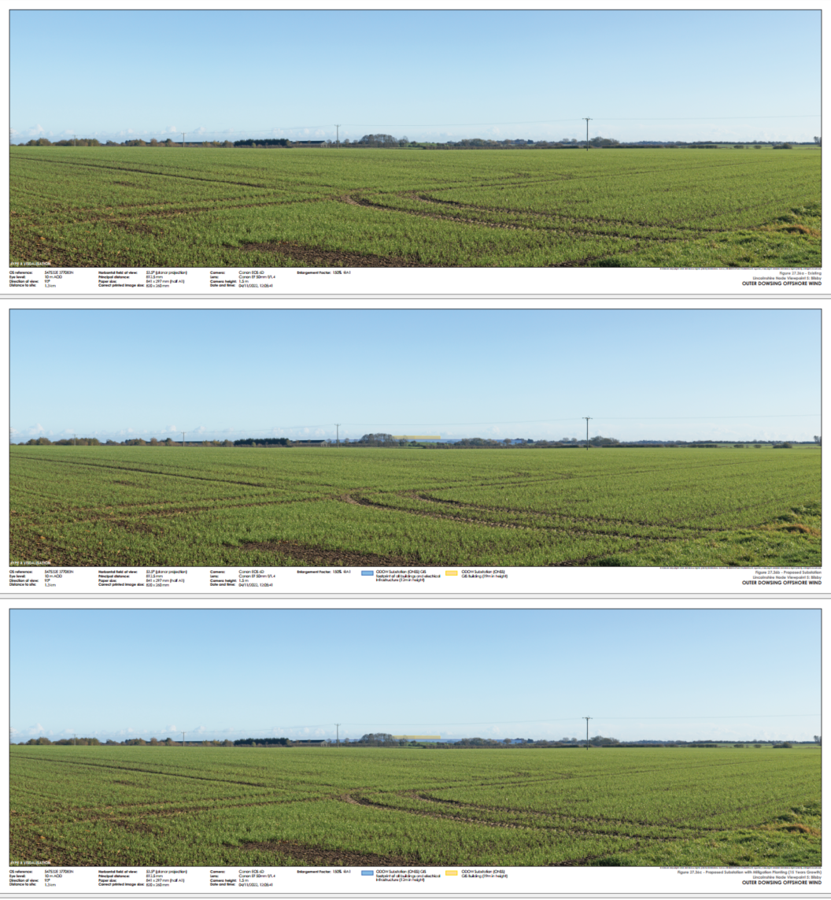
Substation Options – Lincs Node
Existing View
Lincolnshire Node Viewpoint 5: Bilsby
1
2
5
Year 1
3
4
Year 15

Slide 46
Substation Options – Weston Marsh (North & South)

Slide 47
Substation Options – Weston Marsh (North & South)

Slide 48
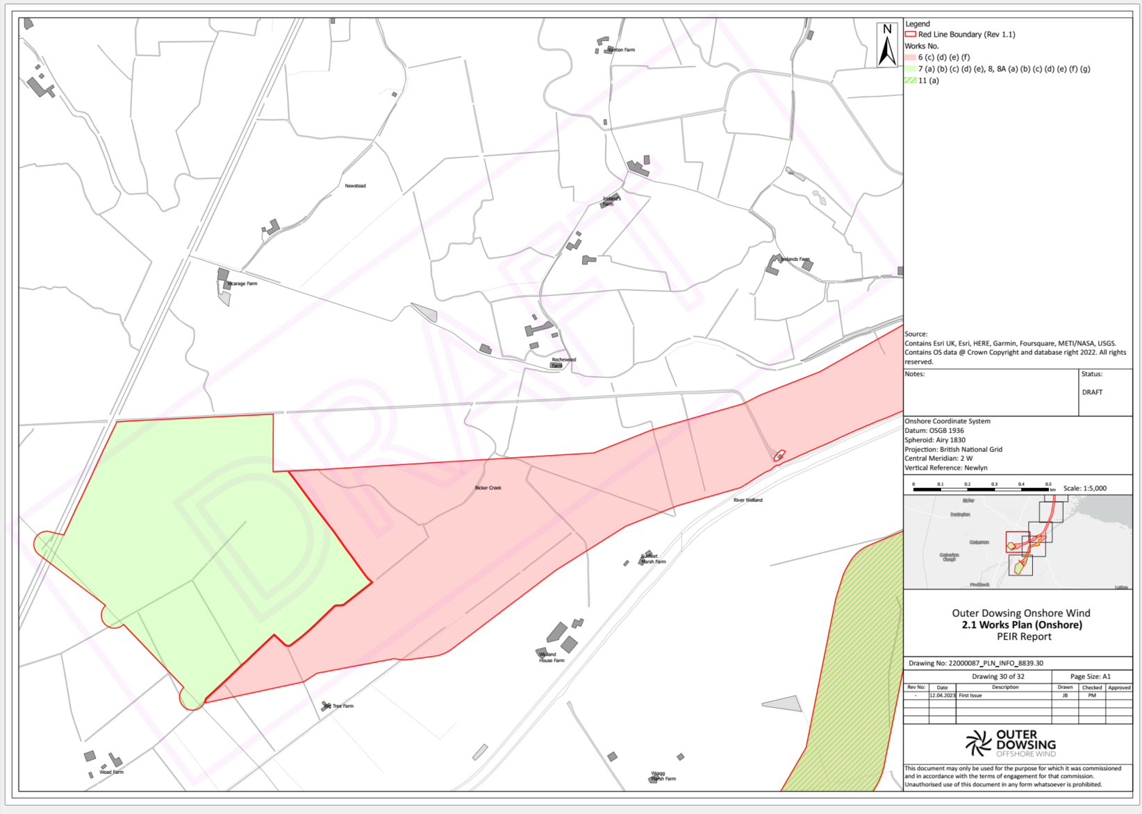

Substation Options – Weston Marsh North

Slide 49


Substation Options – Weston Marsh North
Existing View
Weston Marsh North Viewpoint 1: Marsh Lane near Manor House
2
1
3
5
Year 1
4
Year 15

Slide 50

Substation Options – Weston Marsh North
Existing View
Weston Marsh North Viewpoint 2: A16 near Marsh Lane junction
2
1
3
5
Year 1
4
Year 15

Slide 51

Substation Options – Weston Marsh North
Existing View
Weston Marsh North Viewpoint 3: A16 at Surfleet Bank junction
2
1
3
5
Year 1
4
Year 15

Slide 52

Substation Options – Weston Marsh North
Existing View
Weston Marsh North Viewpoint 4: Macmillan Way at Surfleet Bank
2
1
3
5
Year 1
4
Year 15

Slide 53

Substation Options – Weston Marsh North
Existing View
Weston Marsh North Viewpoint 5: Macmillan Way near Welland House Farm
2
1
Year 1
3
5
4
Year 15

Slide 54


Substation Options – Weston Marsh South

Slide 55


Substation Options – Weston Marsh South
Existing View
Weston Marsh South Viewpoint 1: Marsh Road near Crowtree Farm
1
5
Year 1
2
4
3
Year 15

Slide 56

Substation Options – Weston Marsh South
Existing View
Weston Marsh South Viewpoint 2: Marsh Road near Kindergarten Nursery
1
5
Year 1
2
4
3
Year 15

Slide 57

Substation Options – Weston Marsh South
Existing View
Weston Marsh South Viewpoint 3: B1357 near Loosegate
1
5
Year 1
2
4
3
Year 15

Slide 58

Substation Options – Weston Marsh South
Existing View
Weston Marsh South Viewpoint 4: Carrington Road south
1
5
Year 1
2
4
3
Year 15

Slide 59

Substation Options – Weston Marsh South
Existing View
Weston Marsh South Viewpoint 5: B1357 Common Road north
1
5
Year 1
2
4
3
Year 15

Slide 60

Q&A
Thanks for joining us again this evening! We really appreciate your time and feedback.

