Slide 1


Outer Dowsing Offshore Wind
Community Liaison Group update
Aug 2023

Slide 2
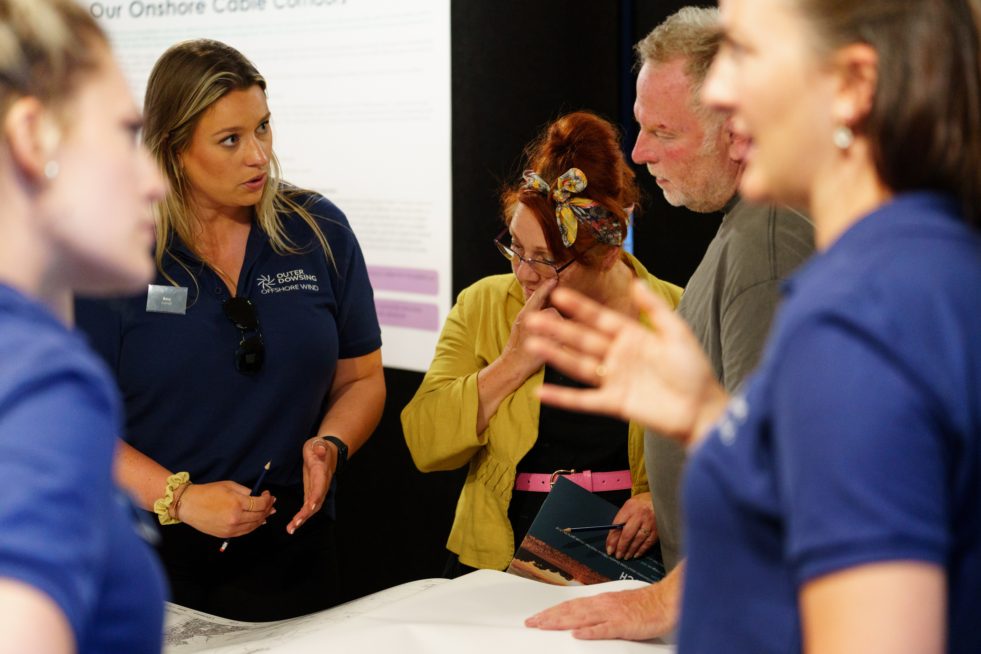

Agenda
Introductions
PEIR consultation update
Detail on grid connection decision
Update on cable route
Next steps
Q&A

Slide 3

Introductions

Slide 4
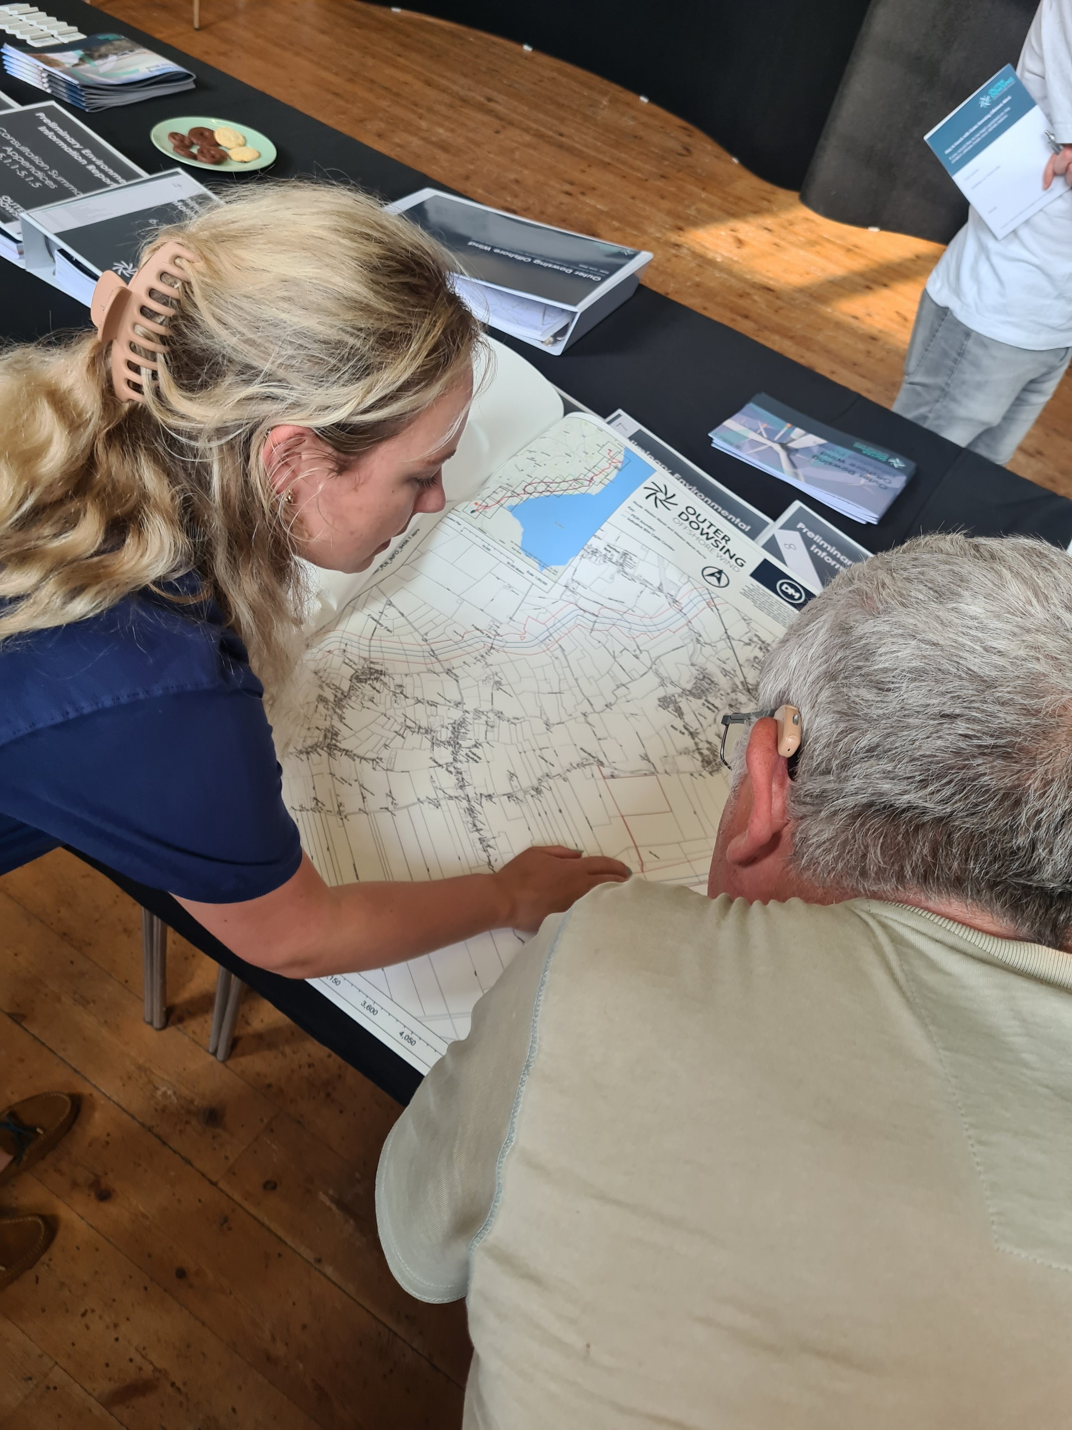
Phase 2 consultation update (PEIR)
Main topics of discussion:
  Noise, traffic & dust;
  Grade 1 land;
  running silts;
  proximity to substations; and,
  Impact to health
437 attendees across the five consultation events
31 attendees across the two webinars
162 feedback cards submitted, many more emails, phone calls and letters
Big increase since Phase 1 consultation. 90% positive feedback

Slide 5
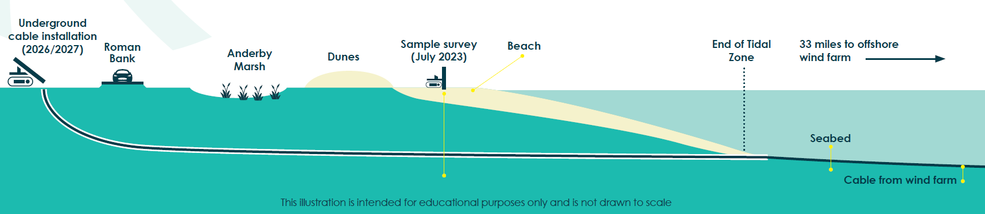
Onshore works update
Ahead of construction (2026/27) it is necessary to assess the subsurface.
To avoid impacts to sensitive areas, such as the beach, we will use horizontal directional drilling.
Samples of the ground allowed our engineers to plan the underground cable installation works.
The samples were taken from a single hole, a few inches in diameter at a depth of roughly 20m. The holes were backfilled leaving little trace of the work.
Samples have been taken successfully from the beach and other onshore areas.

Slide 6
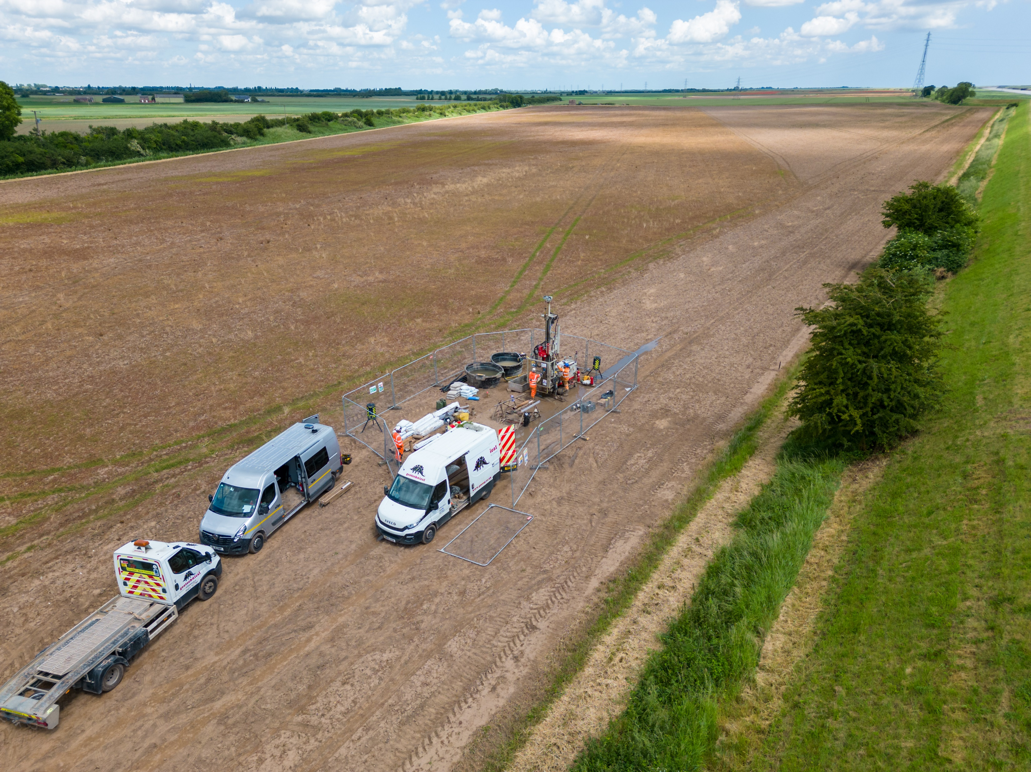

Slide 7
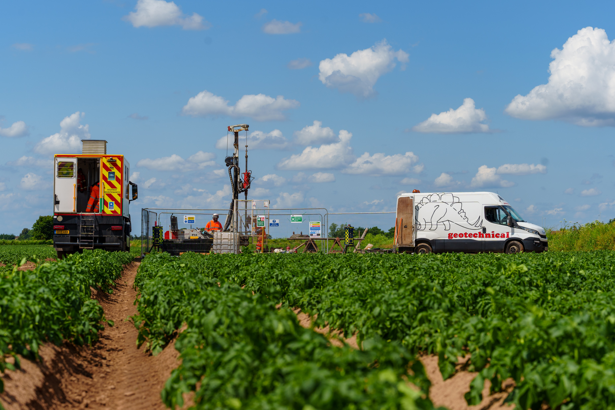

Slide 8
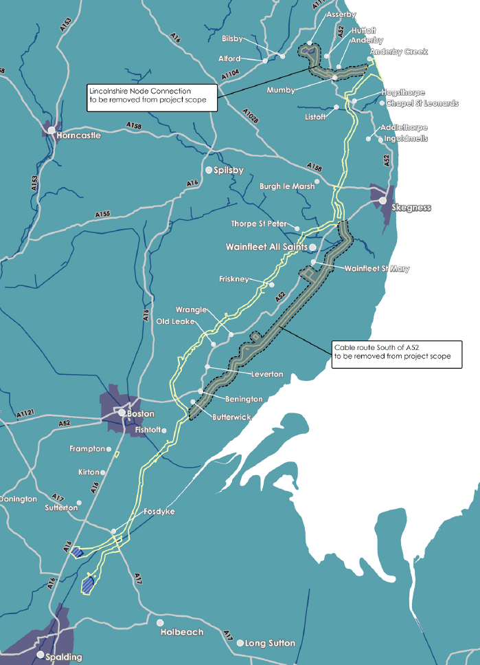
Updated project scope
Lincs Node Connection to be removed from project scope
Subsequent to the follow up appraisal by National Grid Electricity Systems Operator (NGESO) in collaboration with the Transmission Owner, National Grid Electricity Transmission (NGET) we will no longer pursue the Lincolnshire Node connection option
We will continue development activities at the remaining two potential study areas for the substation location, one in the Surfleet Marsh area (previously referred to as Weston Marsh North) and one in the Weston Marsh area (previously referred to as Weston Marsh South)
Cable route South East of the A52 to be removed from scope

Slide 9
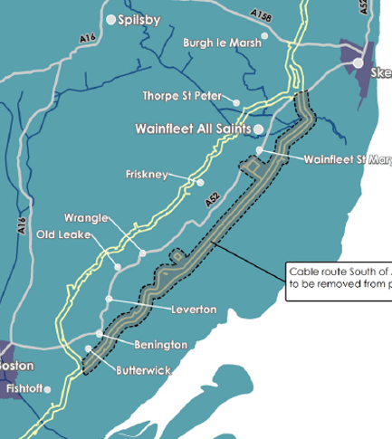
Onshore Cable route update
We will reach the connection point via the cable route northwest of the A52 (the route further away from the coast)
Outer southeast of the A52(the route closer to the coast)
This decision was taken based on the outcome of surveys and consultations to reduce impacts and to incorporate engineering considerations
Cable route South East of the A52 to be removed from scope
Notes:
The key reasons for this recommendation are;​
Engineering- The running silts / sands are more prevalent along Rev 1 would result in significant engineering challenges for installation*;​
Environmental – the engineering methods required along Rev 1 would trigger greater environmental impacts** compared with Rev 1A; and​
Land - the % of Grade 1 agricultural land on Rev 1 is significantly higher*** which would result in higher easement costs, higher crop compensation costs and higher probability for landowner objection.​
Planning Policy – National Planning Policy advocates schemes to avoid Best and Most Versatile (BMV) land classification where there are suitable alternatives.​
Consultation Responses – Phase 2 consultation responses, Community Liaison Groups and bilateral meetings confirmed the above related risks from statutory stakeholders (e.g. National Farmers Union, Lincolnshire County Council, District and Parish Councils) and non-statutory stakeholders.

Slide 10
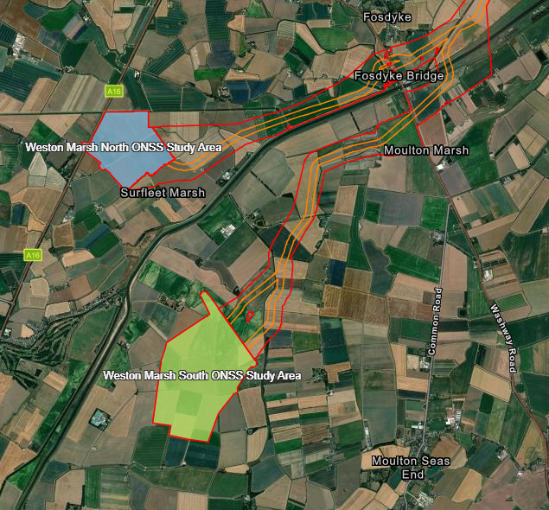
Substation study area update
NGESO’s recommendation is to provide Outer Dowsing Offshore Wind a connection in the Weston Marsh area
We are unable to confirm if the substation will be located within the Surfleet Marsh Study area (previously referred to as Weston Marsh North) or the Weston Marsh study area (previously referred to as Weston Marsh South)
Next steps:
  Continued work with NGET and NGESO
  Autumn consultation to help further refine the design that will be incorporated into our final consent application

Slide 11







Timeline and next steps
Grid Connection and cable route update
DCO examination 2024
Consent decision 2025
DCO submitted Q4 2023
Autumn consultation, Community fund planning
Construction begins 2026/27
First power 2030

Slide 12

Discussion

